Slide 1


LET'S TALK RESEARCH
Identifying Funding Opportunities in the
Arts and Humanities
Office of the Vice Chancellor for Research &
Dean of the Graduate School
May 04, 2023

Slide 2
Outline
National Endowment for the Humanities (NEH)
National Endowment for the Arts (NEA)
Other Agencies
Foundations
Searching for opportunities - PIVOT

Slide 3


National Endowment for the Humanities (NEH)
According to NEH’s enabling legislation, “the term ‘humanities’ includes, but is not limited to, the study and interpretation of the following: language, both modern and classical; linguistics; literature; history; jurisprudence; philosophy; archaeology; comparative religion; ethics; the history, criticism and theory of the arts; those aspects of social sciences which have humanistic content and employ humanistic methods; and the study and application of the humanities to the human environment with particular attention to reflecting our diverse heritage, traditions, and history and to the relevance of the humanities to the current conditions of national life.”
The types of projects range from the scholarly (including books, archives, translations, etc.) to the popular (e.g., museum exhibitions, tours of historic places, documentary films, radio, etc.).
NEH supports 56 states and jurisdictional humanities councils around the country, all of which also make awards to local humanities projects.
In 2022 the NEH supported 258 projects with average direct funds of $90,000 per project

Slide 4
Finding Opportunities with NEH
Searchable database of current and future opportunities
Searchable database of awards
  NEH Grants Section
Other opportunities:
  Annual Summer Stipends Program: $6,000; deadline September 20, 2023
    the program requires tenured or tenure-track applicants to be nominated by an official on their campus, and institutions can nominate up to two people.
    Summer Stipends
  Ad hoc programs. For example:
    Preserve Federal Indian Boarding School Oral History and Records

Slide 5

National Endowment for the Arts (NEA)
NEA has two main funding avenues:
  Research Grants in the Arts funds research studies that investigate the value and/or impact of the arts, either as individual components of the U.S. arts ecology or as they interact with each other and/or with other domains of American life. Matching/cost share grants of $20,000 to $100,000 will be awarded.
  NEA Research Labs funds transdisciplinary research teams grounded in the social and behavioral sciences, yielding empirical insights about the arts for the benefit of arts and non-arts sectors alike. Matching/cost share grants of $100,000 to $150,000 will be awarded.
A biannual NEA program is the Literature Fellowships program: $25,000 grants in prose (fiction and creative nonfiction) and poetry to published creative writers that enable the recipients to set aside time for writing, research, travel, and general career advancement. This program operates on a two-year cycle with fellowships in prose and poetry available in alternating years. In 2023 NEA will be accepting applications in prose (fiction and creative nonfiction).

Slide 6
Engaging with the NEA
Get to know your agency
  Study their 2022-2026 Research Agenda
Get to know the review process. Get to know the Program Directors. Network.
  NEA is looking for Arts Endowment panelists to review applications for funding. Panels are composed of individuals who represent a broad range of artistic and cultural viewpoints, as well as wide geographic and ethnic diversity, to provide advice about the artistic excellence and artistic merit of proposals in a variety of funding categories. Our panels are composed of both arts professionals and knowledgeable laypersons.
NEA maintains a database to help them identify and select panelists.

Slide 7

Other Agencies
Other Federal agencies support art and humanities projects. Examples:
The National Science Foundation has the Science and Technology Studies (STS) (previously known as the the Science, Technology and Society Program). STS is an interdisciplinary field that investigates the conceptual foundations, historical developments and social contexts of science, technology, engineering and mathematics (STEM), including medical science. The STS program supports proposals across a broad spectrum of research that uses historical, philosophical and social scientific methods to investigate STEM theory and practice.
Deadline: August 3, 2023

Slide 8

Other Agencies
  The National Institutes of Health (NIH) through the National Library of Medicine have the G13 program to support scholarly works in Biomedicine and Health
  Support the preparation of books or other works focusing on the history or philosophy of medicine, public health and the life sciences, the development of medical research and health services, bioethics, and studies on the interrelationship of medicine and society
  Works focusing on the history or philosophy of biomedical informatics, computational biology, health information sciences, health communications, or health sciences librarianship
  Analytical and comprehensive critical reviews which identify the present status of research and practice in various health-related fields, addressing advances which have been made, problems requiring examination, and emerging trends
Currently not active; awaiting new budget

Slide 9
Foundations
  Too many. How to find?
    Hanover Research

Slide 10

Foundations
  Too many. How to find?
    CANDID

Slide 11
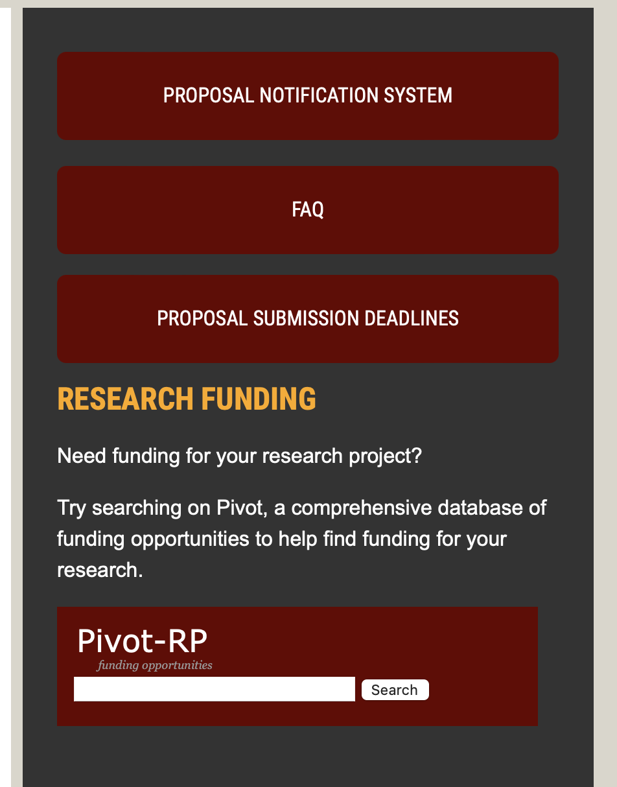
Searching for Opportunities
  Pay no money and use an OSPA resource
    PIVOT

Slide 12
PIVOT
Kelly Alongi will discuss registering in PIVOT

Slide 13
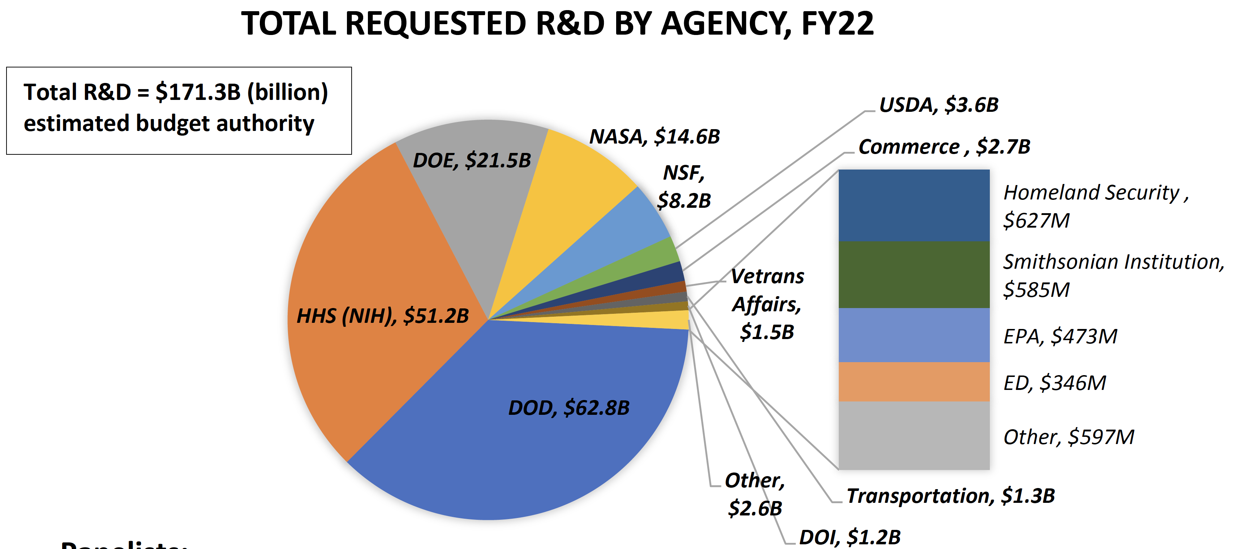
Funding Landscape

Slide 14
Building Partnerships Across Campus
In Fall 2023 we will organize events to bring faculty together
Participate
Large problems require diverse research teams

Slide 15

Thank you for your attention!

