Slide 1

Full Disclosure: Other Support
Federal Disclosure Requirements for Researchers
Let’s Talk Research Series
January 28, 2026

Slide 2
What is Other Support?
All resources made available to support or relate to your research
Includes items with or without monetary value
Includes resources outside your home institution

Slide 3
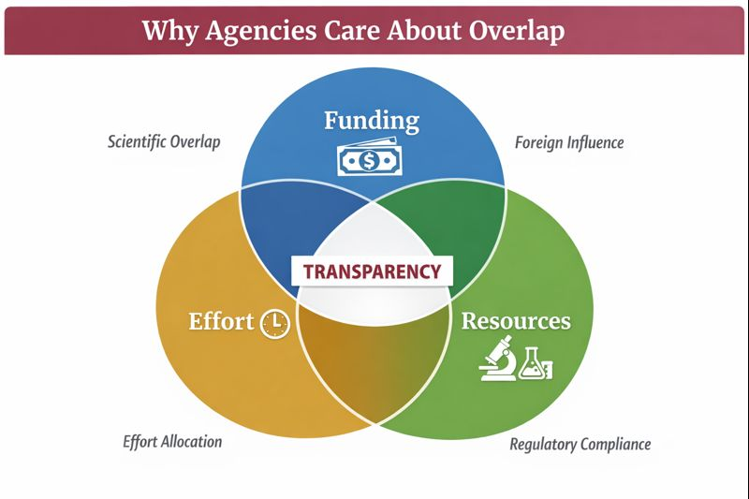
Why do federal agencies care?
Identify scientific and budgetary overlap
Access total effort commitments
Understand foreign and domestic collaborations
Meet federal transparency requirements

Slide 4
Why This Matters
Federal agencies now require full transparency of:
  Funding
  Appointments
  Outside activities
Errors or omissions can lead to:
  Proposal delays or rejection
  Award suspension or termination
  Required repayment of funds
  Compliance investigations

Slide 5
NSPM-33: Why Are Rules Changing
Federal policy (2021) on research security
Standardizes disclosures across agencies
Addresses foreign influence & conflicts of commitment
Impact on Faculty
  More detailed disclosures
  Consistent reporting across proposals
  Increased review of “other support”

Slide 6
Who Must Disclose?
Key Personnel = anyone who contributes measurable effort, even if not paid.

Slide 7
When to Disclose
Proposal Submission
Just-in-Time
Annual Reporting or Change
Award Acceptance

Slide 8
What must be disclosed as other support?
Key Personnel must disclose all of the following:
Category | Examples
Sponsored Projects | Grants, contracts, fellowships, etc.
Not-sponsored support | Lab space, staff, or equipment provided by another organization
In-kind contributions | Free materials, animals, services
Appointments (effort/time commitment) | Visiting, honorary, adjunct, unpaid research appointments
Foreign affiliations | Talent programs, labs, universities
Consulting | Paid or unpaid research-related work

Slide 9
Where You Disclose this in a Proposal
Current & Pending (Other) Support Form
Biosketch – Positions & Appointments
Facilities & Other Resources (if applicable)
Conflict of Interest Disclosures (COI/COC/FCOI)
Sponsor-specific forms

Slide 10
What is NOT “Other Support”
Does not include:
  Standard academic service (journal editing, peer review)
  Professional society memberships
  Teaching unrelated to research
  One-time honoraria for lectures (unless tied to research)

Slide 11
In-Kind Contributions – High Risk Area
These are non-cash resources provided for research, such as:
  Lab space at another institution
  Graduate students paid by another organization
  Equipment or materials
  Cloud computing or software
  Animals or reagents
  Access to proprietary data
If another organization is helping you do research, it is likely in-kind support

Slide 12
What about gifts?
Other support does not include training awards, prizes, or gifts.
True gifts = no expectations. If effort, services, or research use is expected, it is not a gift.

Slide 13
Foreign Support
Must disclose:
  Foreign grants or contracts
  Visiting scientist roles
  Talent programs
  Joint labs or centers
  Sponsored travel tied to research
  Honorary or unpaid foreign appointments
Even if:
  No money is paid
  It is outside SIU
  Old or inactive

Slide 14
Time Commitment Matters
Federal agencies require disclosure of:
  All professional time
  Even if unpaid
  Even if outside SIU
Example:
  If you work 10% of your time in a foreign lab, it must be disclosed.

Slide 15
Common Mistakes
“It’s unpaid so I don’t list it”
“It’s a gift, not a grant”
“It’s not through SIU”
“It’s not in my current project”
“I forgot about that visiting appointment”
These are not valid reasons for omission.

Slide 16
What agencies cross-check
Federal agencies compare information across:
  Biosketch
  Current & Pending Support
  Other Support
  Conflict of Interest forms
  Publication affiliations
  Foreign visa records
  Public websites
  Institutional records
Inconsistencies trigger investigations.

Slide 17
What Happens if Something is Missed
Potential consequences:
  Award suspension or termination
  Return of grant funds
  Loss of future eligibility
  University reporting to federal agencies
  Inspectors General investigation

Slide 18
How SIU Helps
OSPA will:
  Coordinate review of disclosures with the Office of Research Compliance and if applicable, Export Control
  Help interpret what must be reported
  Work with faculty before submission
  Submit required updates to sponsors
Always ask before leaving something out.

Slide 19
The Golden Rule
When in doubt:
Disclose it.
It is always safer to over-report than under-report.

Slide 20
Knowledge Check – Should You Disclose?

Slide 21
A professional society gives you a travel award to attend a conference. No research work is required.
NO – Standard professional activity, not research support
A foreign university gives you an unpaid “Adjunct Professor” title. You occasionally advise a student there.
YES, unpaid foreign appointments must be disclosed
A colleague at another university runs analyses for your project using their lab’s computing cluster at no cost.
  YES – this is an in-kind research resource

Slide 22
You are a peer reviewer for NIH and NSF panels.
NO – Routine service to funding agencies does not need to be disclosed
A company provides free reagents that you use in a federally funded project.
YES – free research materials = in-kind contribution
You give a one-time paid guest lecture at another university unrelated to your research.
  NO – not research-related support
You are listed as a collaborator on a foreign grant but receive no salary.
YES – participation in foreign-sponsored research must be disclosed

Slide 23
Key Takeaway
If something is helping you conduct research — funding, time, space, equipment, people, or collaborations — there is a good chance it needs to be disclosed somewhere.

Slide 24

Questions

