Slide 1
NIH Funding Mechanisms
Farhan Chowdhury, Ph.D.
School of Mechanical, Aerospace, and Materials Engineering
Southern Illinois University Carbondale
farhan.chowdhury@siu.edu
November 6, 2024

Slide 2

NIH’s mission is to seek fundamental knowledge about the nature and behavior of living systems and the application of that knowledge to enhance health, lengthen life, and reduce illness and disability.
2

Slide 3
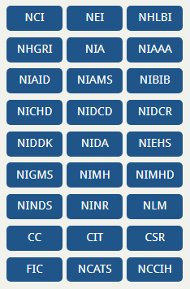
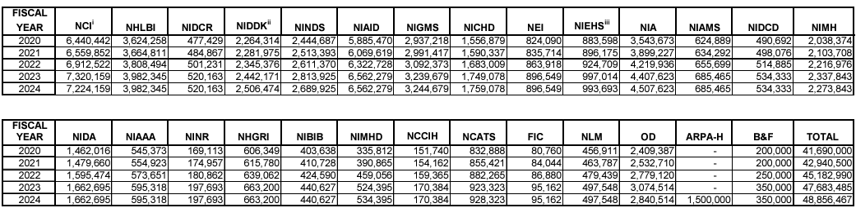
Institutes and Center at NIH
Amounts in thousands of dollars
Total Budget- $48.86 billion (FY 24)
https://www.nih.gov/institutes-nih/list-institutes-centers
https://officeofbudget.od.nih.gov/approp_hist.html
3

Slide 4
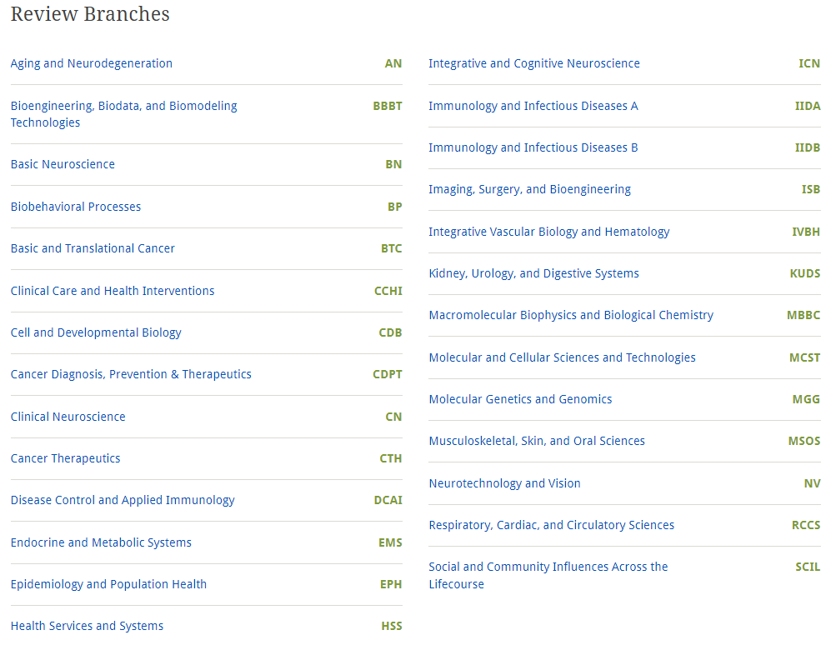
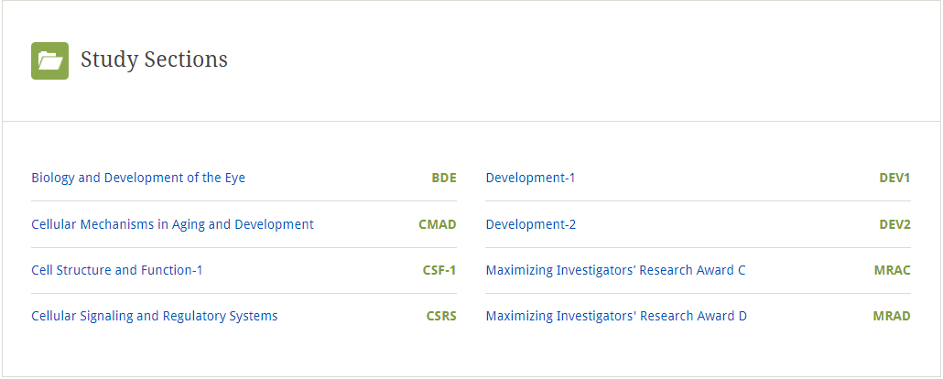
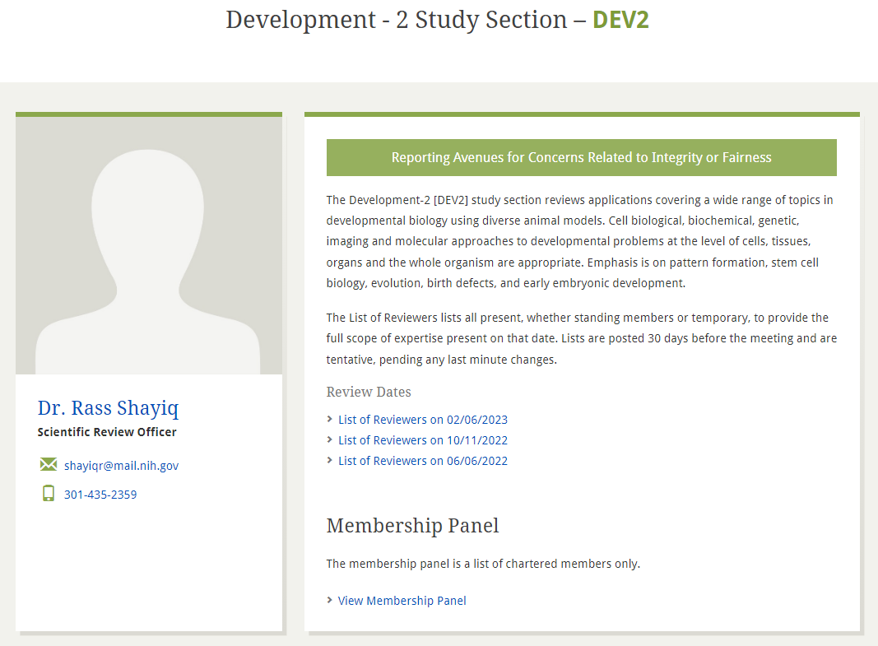
CSR is Organized into Review Branches
https://public.csr.nih.gov/StudySections/ReviewBranches
https://public.csr.nih.gov/StudySections/DBIB/CDB
4

Slide 5
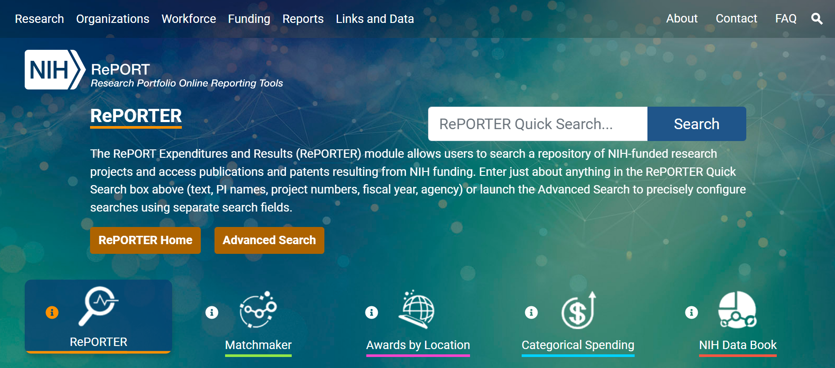
NIH RePORTER provides details about reporting Expenditure and Outcomes
https://report.nih.gov/

Slide 6
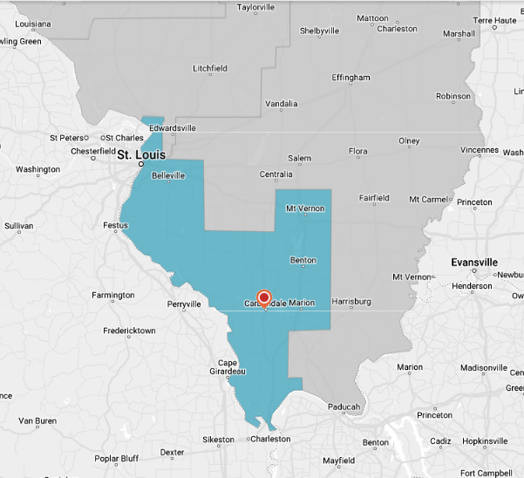
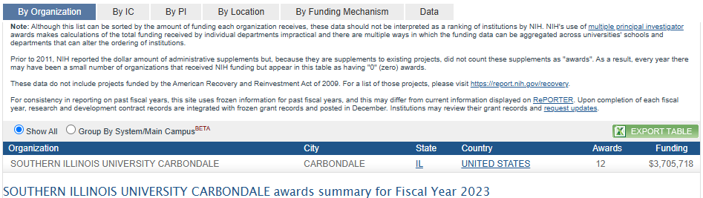
Congressional District: IL-12
FY Year: 2023
Projects: 12
Budget: $3,705,718
6

Slide 7
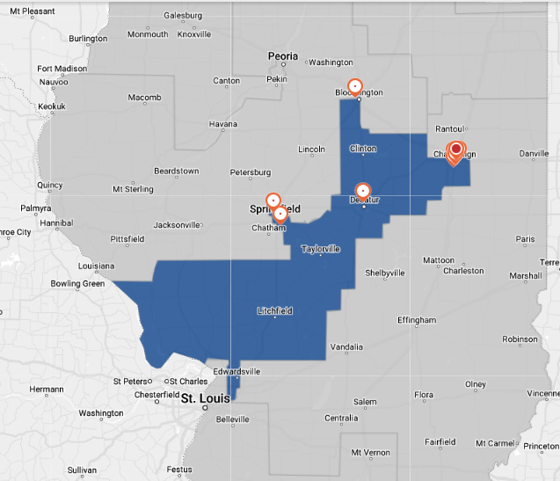
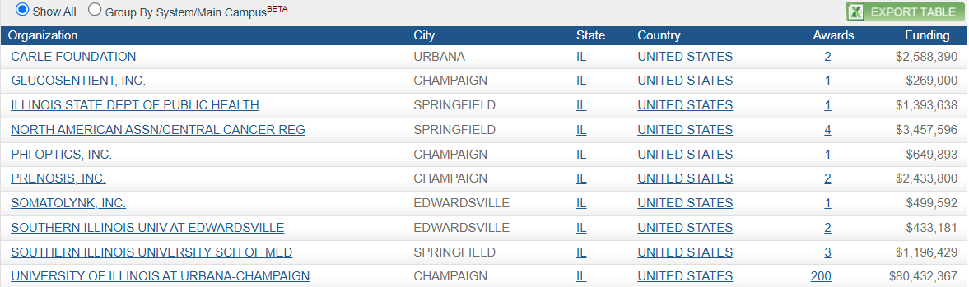
Congressional District: IL-13
FY Year: 2023
Projects: 217
Budget: $93,353,886

Slide 8
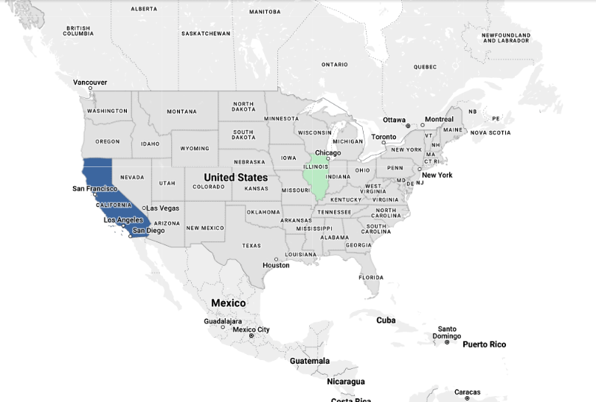
Comparing IL to CA for funded NIH Grants
State: CA
FY Year: 2023
Projects: 9085
Budget: $5,312,211,239
State: IL
FY Year: 2023
Projects: 2368
Budget: $1,233,379,171
FY Year: 2023
Johns Hopkins- $842 million
WashU- $633 million
Notes:
FY 23: Johns Hopkins- $842 million

Slide 9
How to apply- Video Tutorials
https://grants.nih.gov/grants/how-to-apply-application-guide/video/index.htm

Slide 10
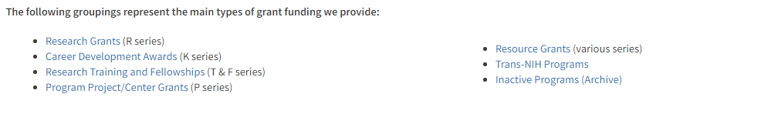
Type of Grants
https://grants.nih.gov/grants/funding/funding_program.htm
https://grants.nih.gov/grants/funding/ac_search_results.htm

Slide 11
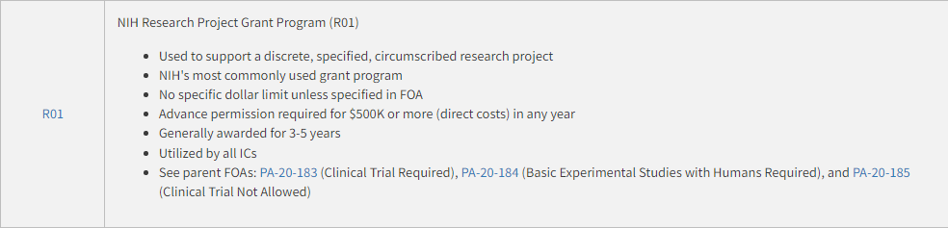
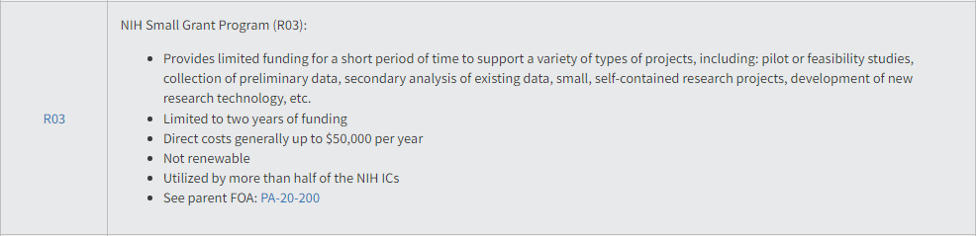
Type of Grants (Cont.)

Slide 12
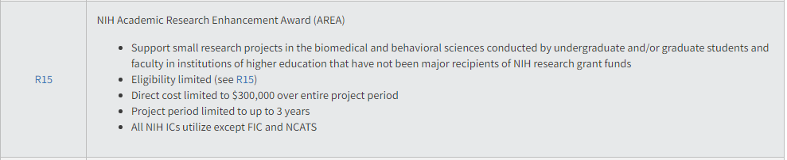
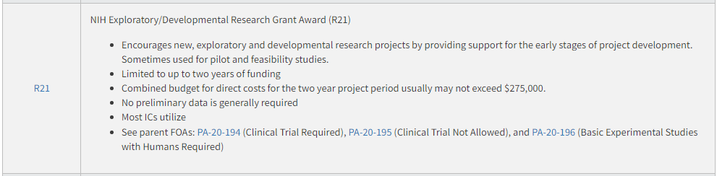
Type of Grants (Cont.)
$375,000

Slide 13
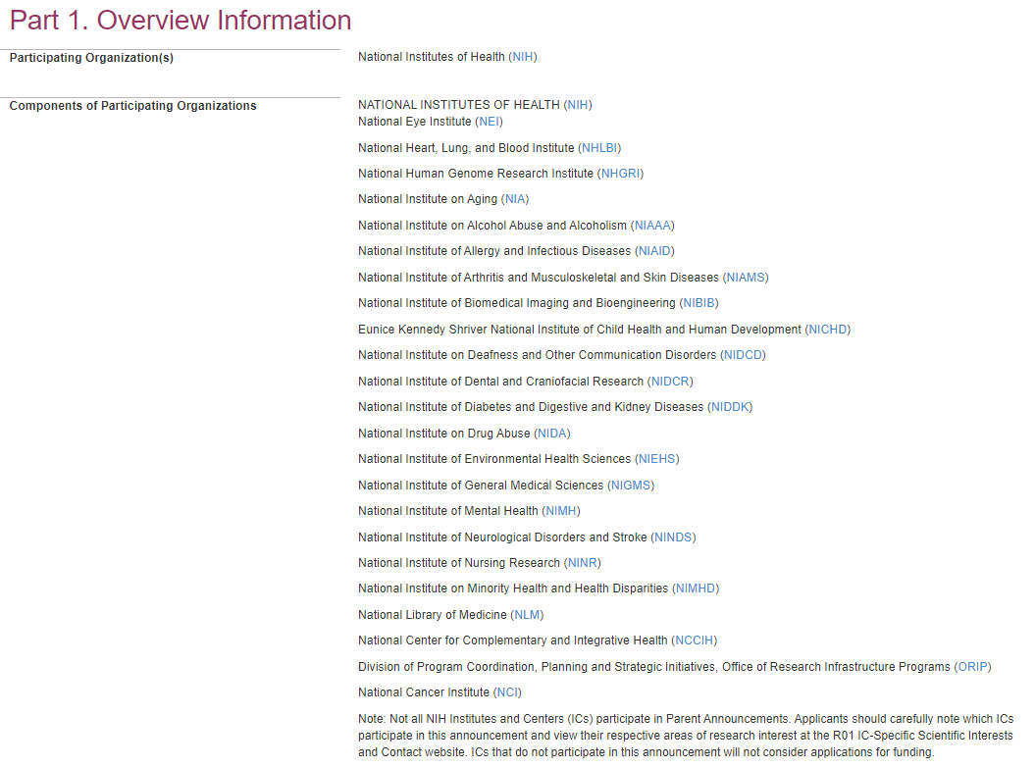
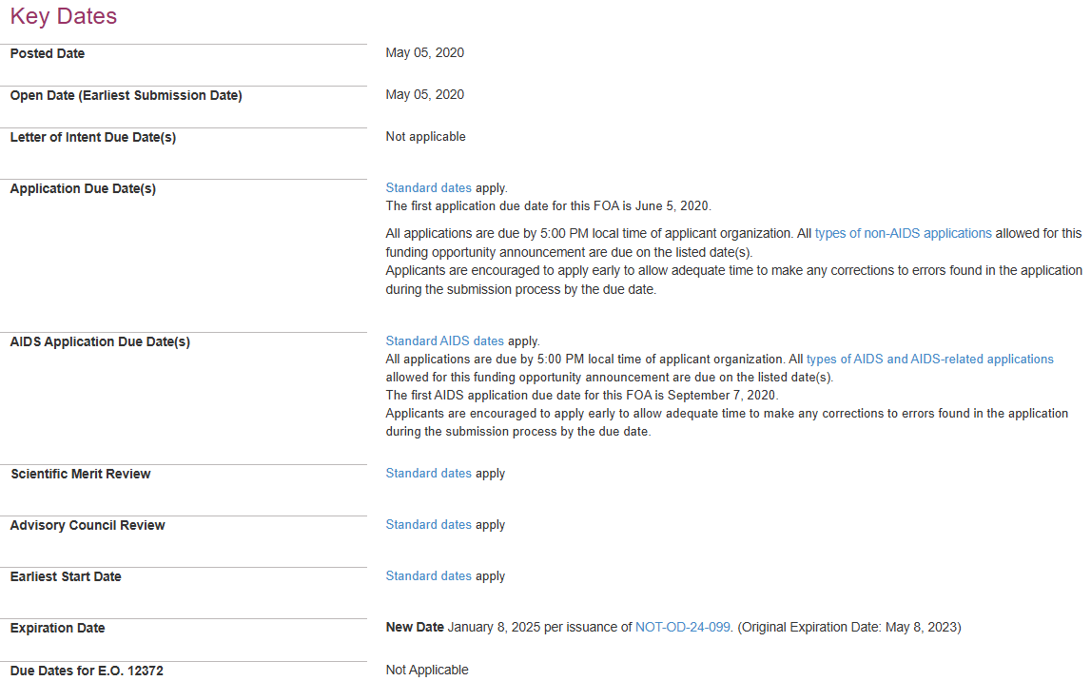
Funding Opportunity Announcement (FOA) Number: PA-20-185
https://grants.nih.gov/grants/guide/pa-files/PA-20-185.html

Slide 14
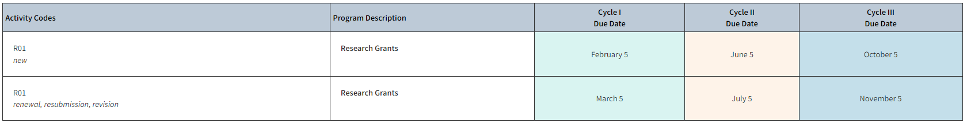
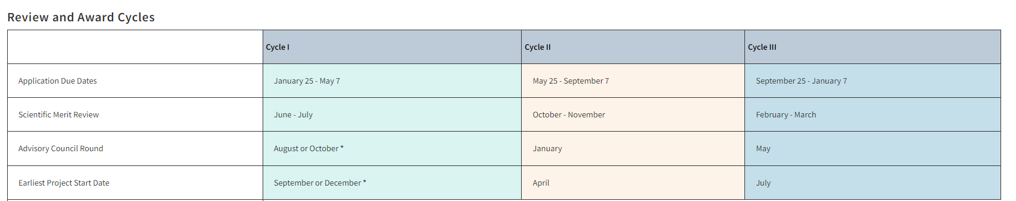
Standard Dates
https://grants.nih.gov/grants/how-to-apply-application-guide/due-dates-and-submission-policies/due-dates.htm

Slide 15
Sample Applications and Summary Statements
Research grants: R01, R03, R21, R15
Small Business grants: R41, R42, R43, R44
Training and Career grants: K01, K08, F31
U01
Data Sharing Plan
Genomic Data Sharing Plan
Rigor and Reproducibility
https://www.niaid.nih.gov/grants-contracts/sample-applications

Slide 16
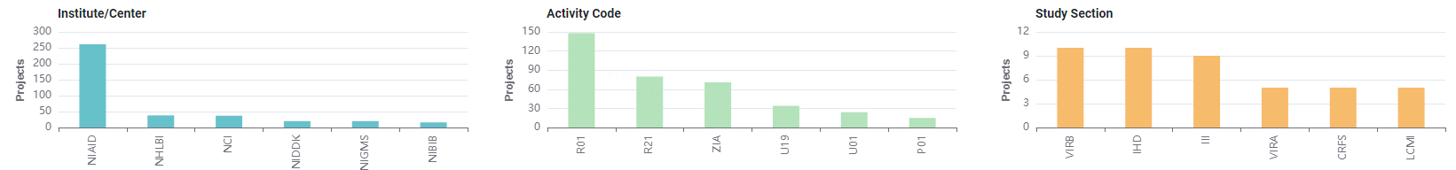
Matchmaker
You can submit scientific texts to determine which similar projects that have been funded by the NIH.
Example:

Slide 17
Early Career Reviewer (ECR) Program
https://public.csr.nih.gov/ForReviewers/BecomeAReviewer/ECR

Slide 18
NI and ESI- two special status
https://grants.nih.gov/policy-and-compliance/policy-topics/early-stage-investigators
ESI MIRA (R35) Webinar Video: https://youtu.be/O77J9jH93G4
FOA: https://grants.nih.gov/grants/guide/pa-files/PAR-23-145.html
  Next deadline: February 3, 2025

Slide 19
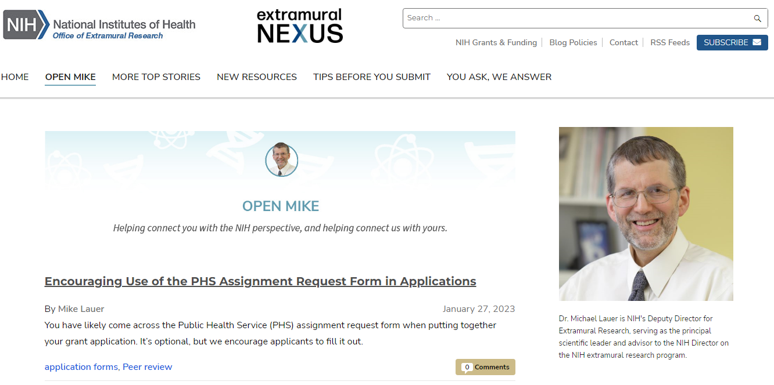
Open MIKE Blog
(Connecting the Investigator to the NIH Perspective)
https://nexus.od.nih.gov/all/category/open-mike/

Slide 20
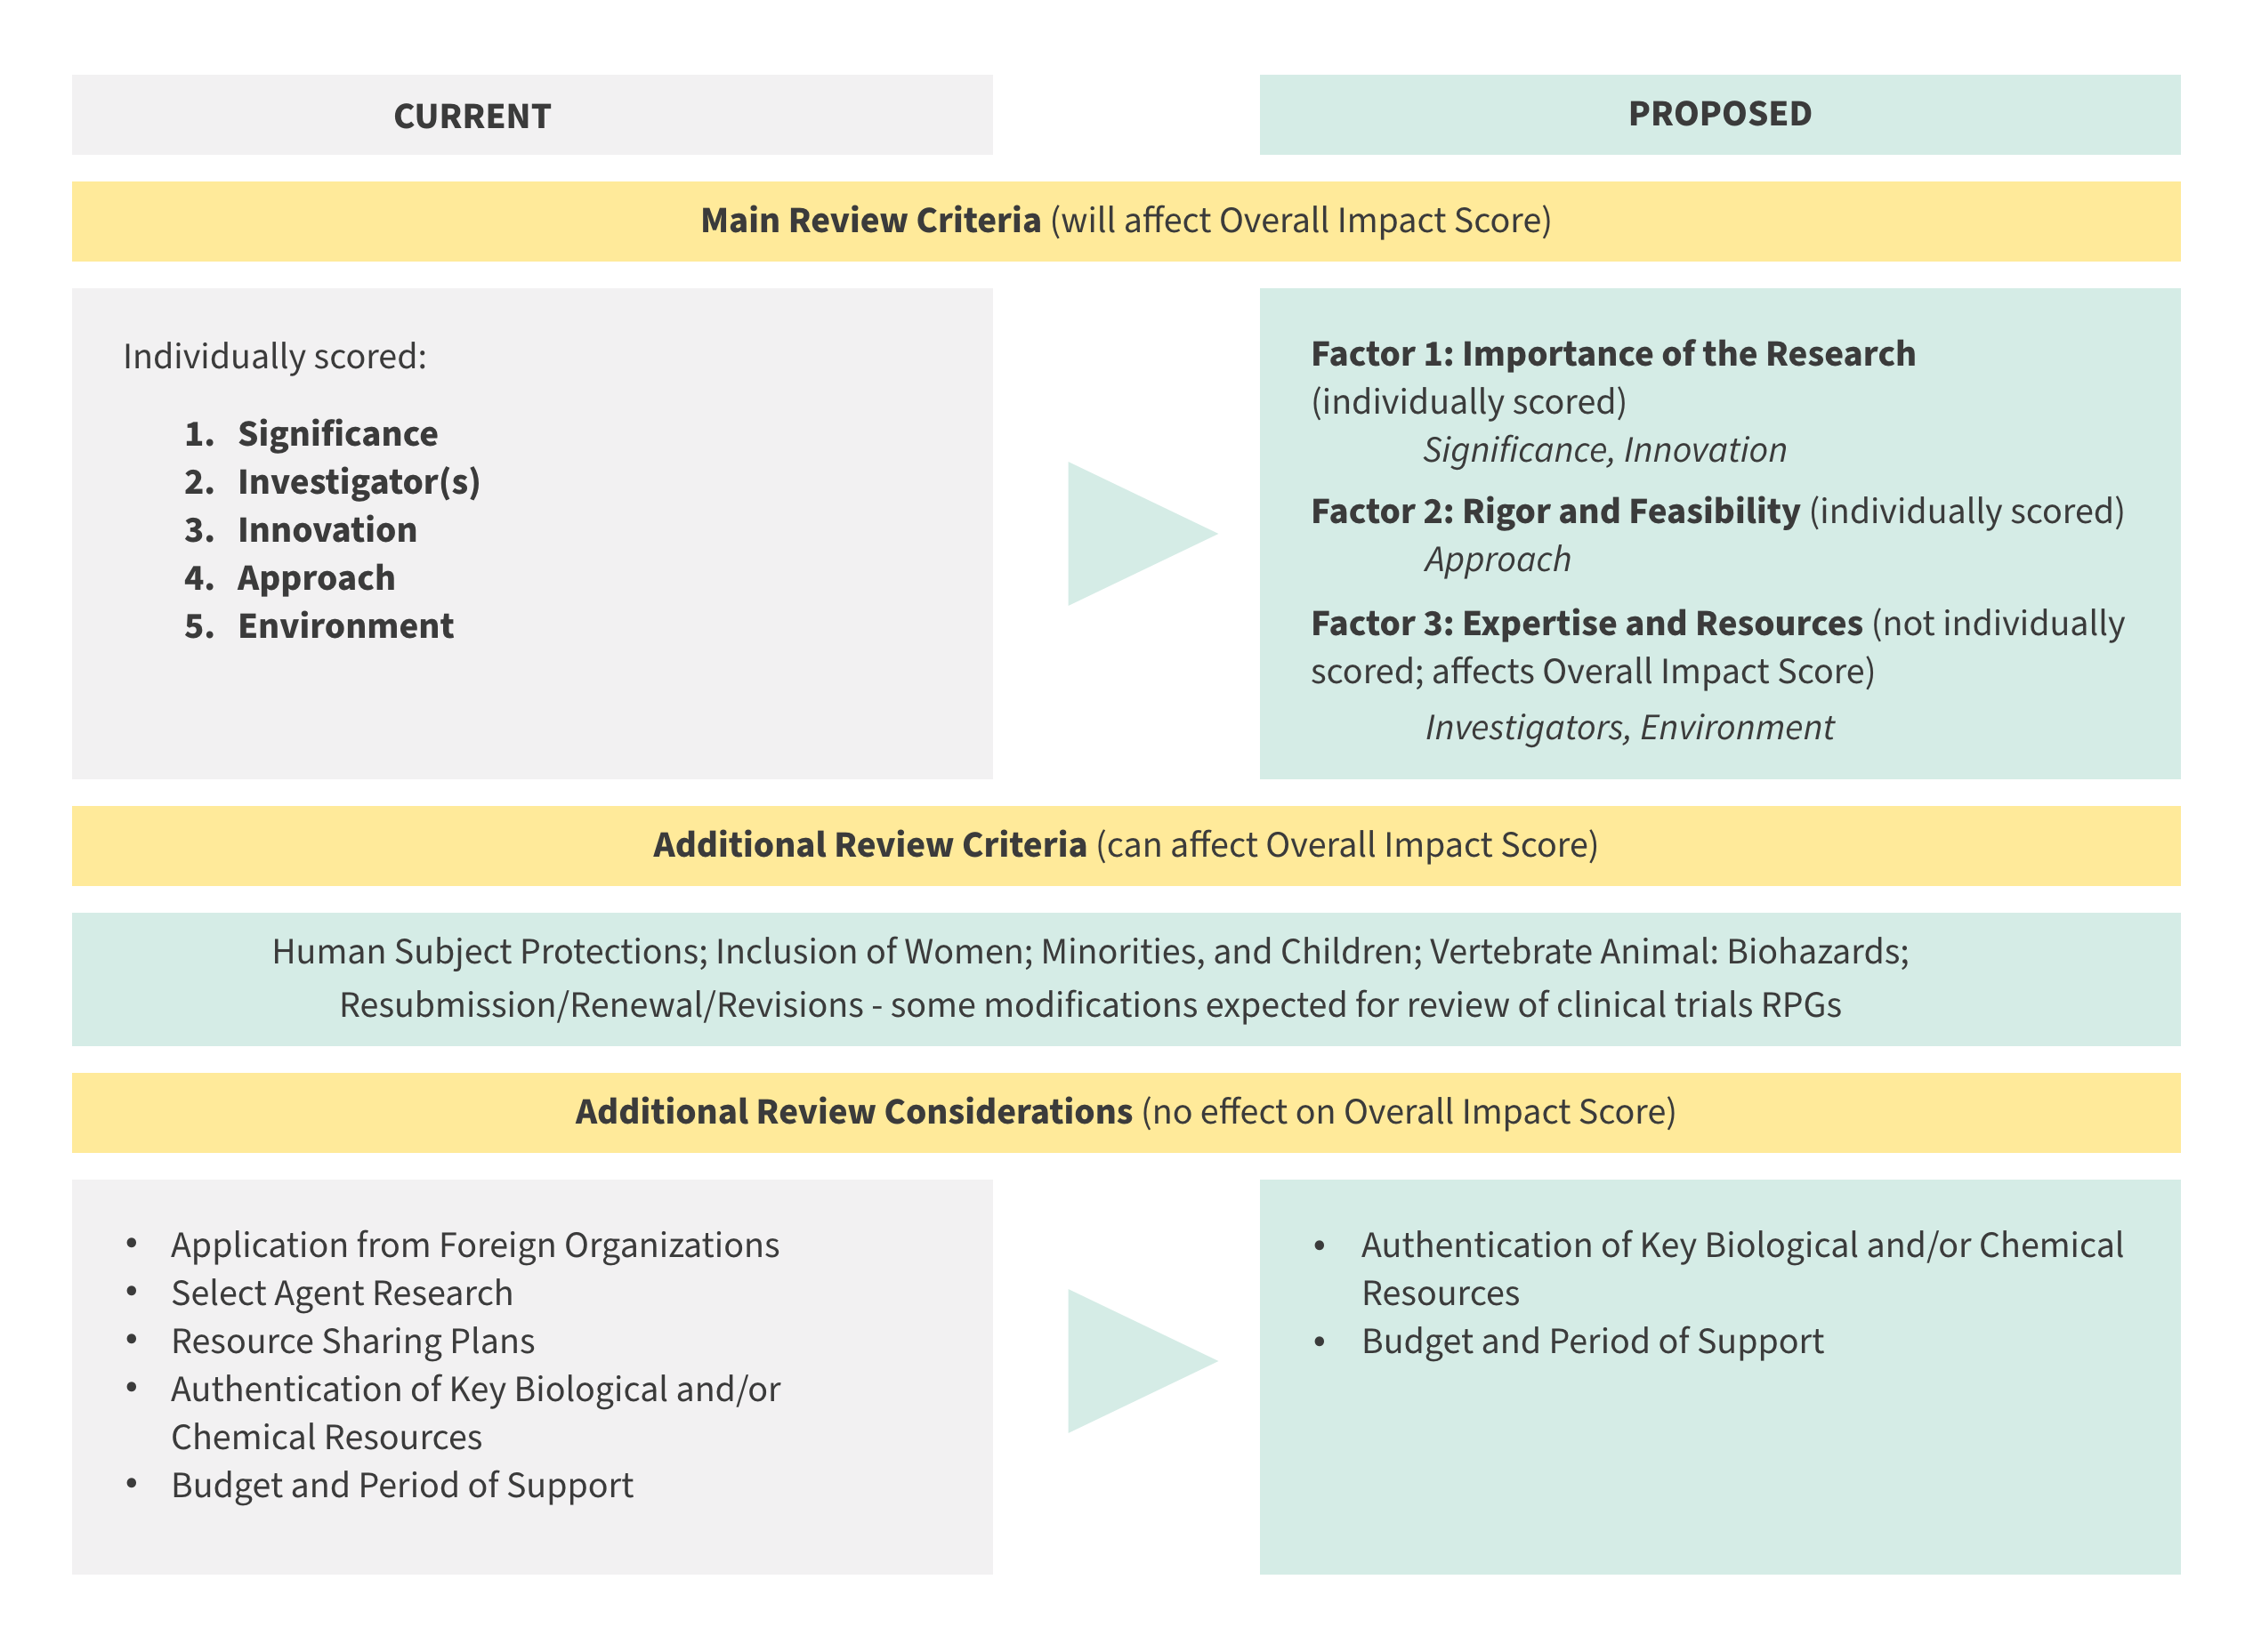
Changes in Review Criteria
With the submission deadline on or after January 25, 2025 – there will changes in how most of the NIH research grant applications will be reviewed. Please see the link below:
https://grants.nih.gov/policy-and-compliance/policy-topics/peer-review/simplifying-review
https://nexus.od.nih.gov/all/2022/12/08/update-on-simplifying-review-criteria-a-request-for-information/
https://grants.nih.gov/grants/guide/notice-files/NOT-OD-23-034.html

Slide 21

ধন্যবাদ

