Slide 1

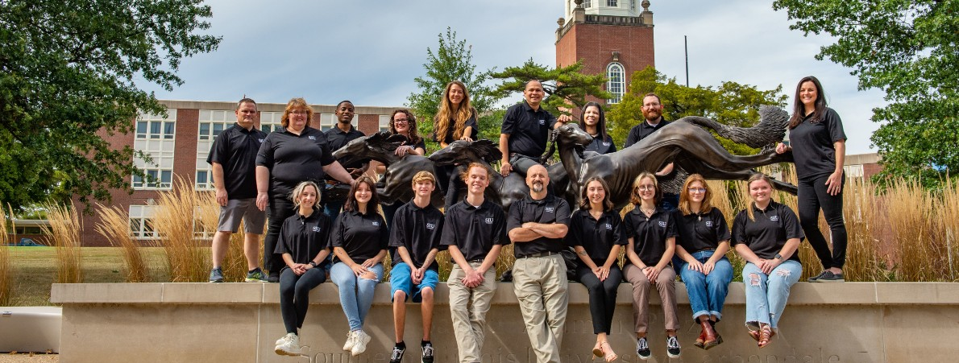

Slide 2




NASA Programs and Activities
Solar STEAM
PI: Harvey Henson Co-Is: Bob Baer, Cori Brevik, Justin McDaniel, Blair Allen & Michelle Nichols
Agency: NASA (Invited) Dates: 8/21/23 - 6/30/26 ($3,987,178)
Dynamic Eclipse Broadcast (DEB) Initiative
PI Bob Baer Co-Is: Harvey Henson, Cori Brevik, Matt Penn, Heidi Bjerke & David Gerdes
Agency: NASA Dates: 4/25/2023 – 4/24/2025 ($314,440)

Slide 3
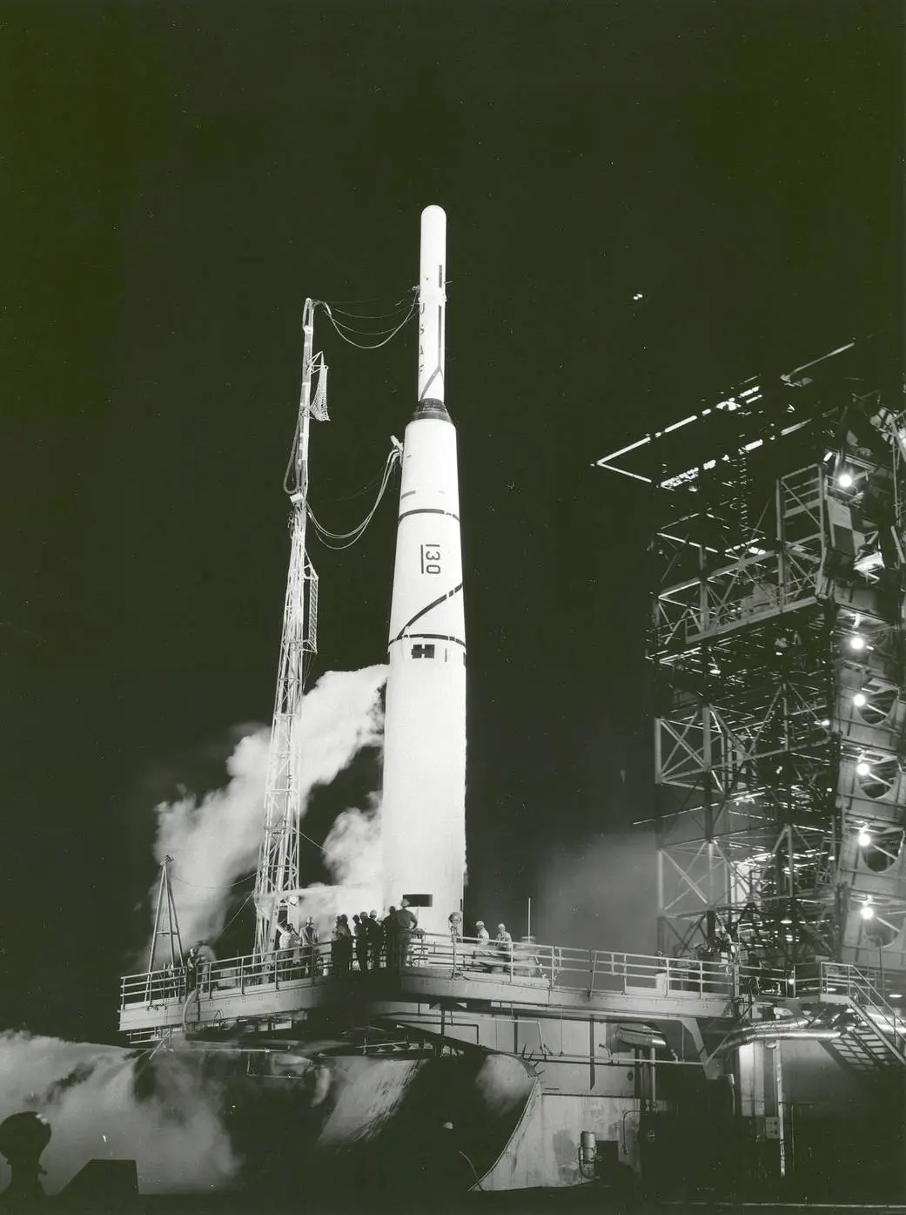
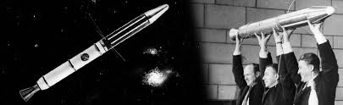
NASA MISSIONS
October 11, 1958
Pioneer 1 Launched

Slide 4
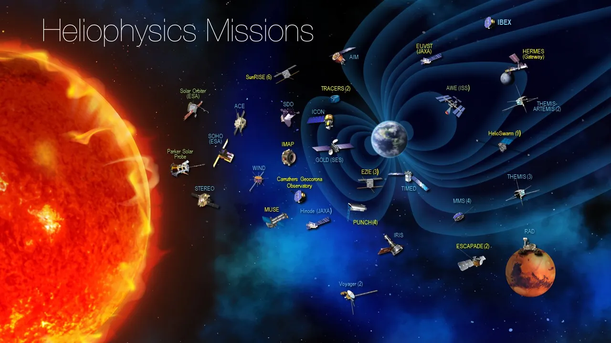
NASA MISSIONS
Heliophysics Division mission fleet as of July 2024

Slide 5
Navigate NASA’s various funding opportunities
NASA’s Main Funding Programs:
NASA Research Announcements (NRAs)
Small Business Innovation Research (SBIR)
Small Business Technology Transfer (STTR)
Collaborative Research with Academia and Industry

Slide 6
NASA’s Mission and Research Areas
Identify Context and Develop Understanding of NASA’s overall mission and research priorities.
  NASA’s Vision and Mission
  Key Areas of NASA’s Work: Aeronautics, Space Exploration, Earth Science, Astrophysics, Technology Development
  Types of Funding Opportunities: Research, Innovation, Technology, Small Business Support
  NASA’s Open Call for Proposals: Understanding the Agency’s Needs and Strategic Goals

Slide 7
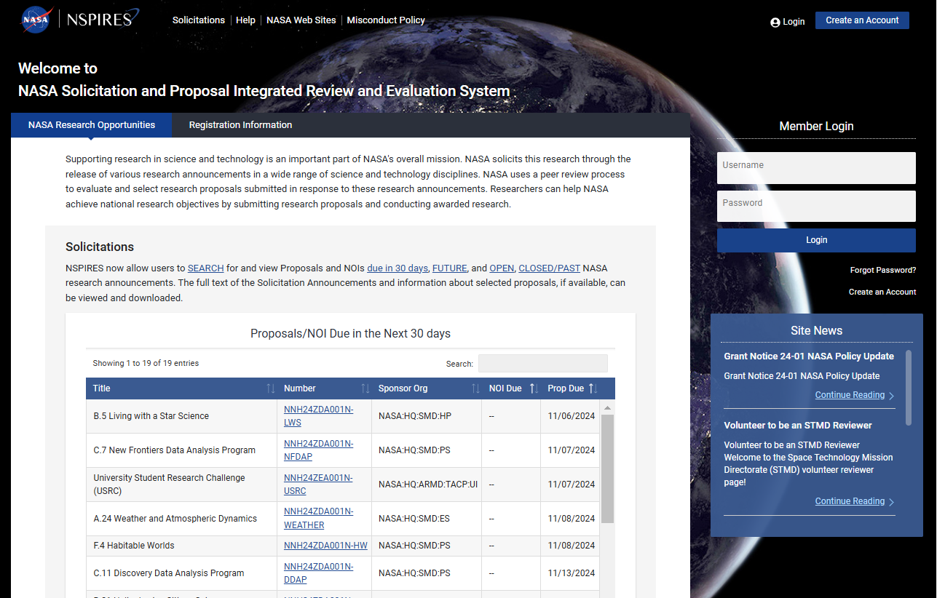

NASA Research Opportunities Online
Connecting with NASA Program Officers
How to Find Open Solicitations and Opportunities
NSPIRES

Slide 8
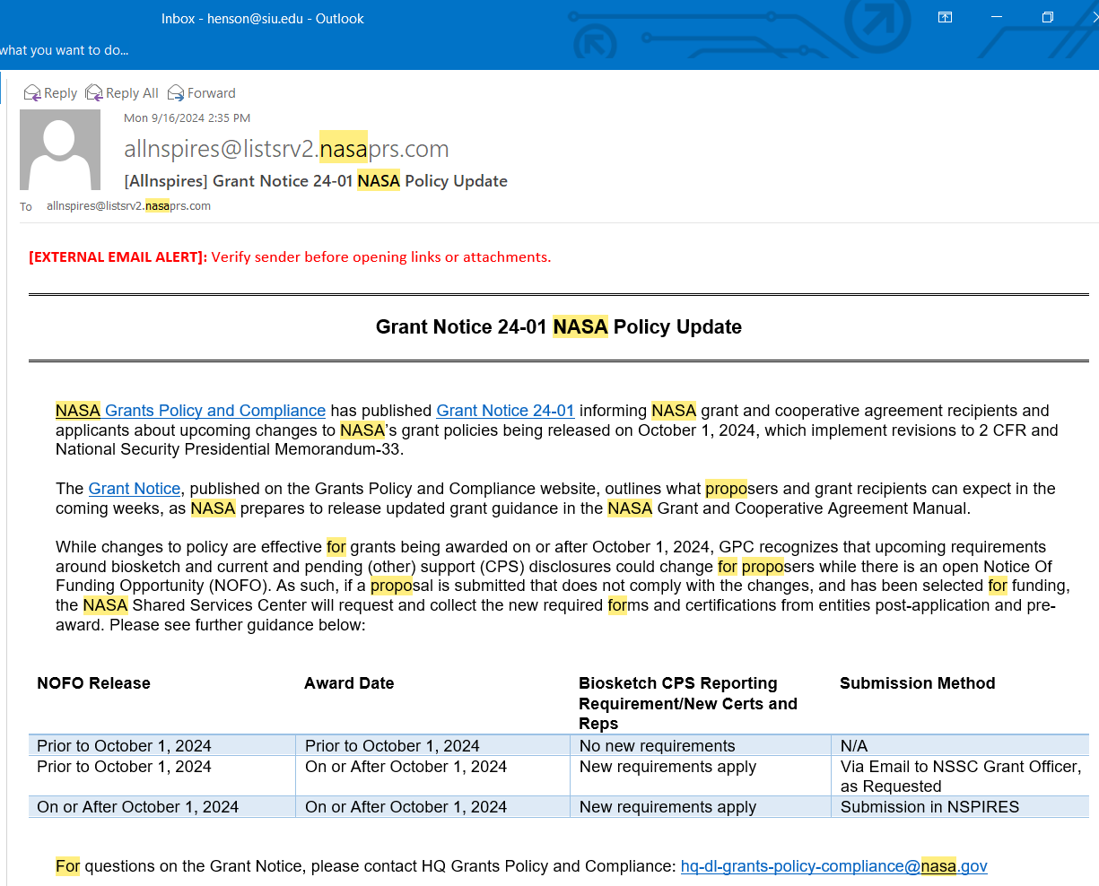
NASA Research Opportunities Onlline
Sign Up on NSPIRES

Slide 9
Submitting a Successful Proposal
Steps of submitting a successful proposal to NASA (NPSIRES)
Identifying a Problem/Research Question Relevant to NASA
Clarity and Alignment with NASA’s Strategic Objectives
Reviewing the Solicitation and Requirements
Important/Competitive Proposal Components:
Abstract/Executive Summary
Research Objectives and Goals
Methodology and Approach
Budget and Timeline
Team/Collaborators and their Roles
Evaluating Outcomes and Deliverables

Slide 10
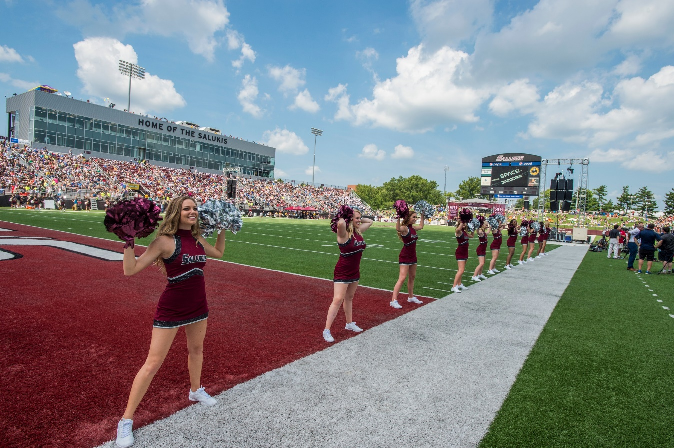

Slide 11


Thank You.

