Slide 1


INTRODUCTION TO FUNDED RESEARCH
Date: Wednesday, February 14, 2024
Time: 11:00 am​ - noon
Location: Morris Library 752​

Slide 2
Office of Sponsored Projects Administration

Slide 3
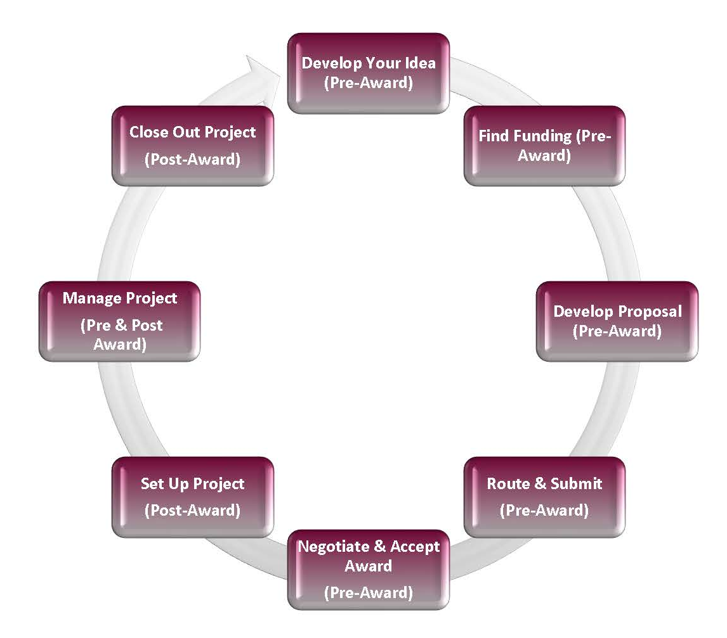
About Us
OSPA is a unit of the Office of the Vice Chancellor for Research, consisting of two teams – Pre & Post
OSPA’s mission: facilitate, support and advance research efforts
OSPA is the campus unit designated to submit grant proposals and accept awards on behalf of the university
OSPA provides oversight to ensure sponsored activities comply with federal, state and university policies and regulations

Slide 4
Services Provided by OSPA
Assist in finding funding opportunities
Facilitate and guide proposal development, budget preparation, etc.
Review, approve and submit proposals
Negotiate and accept awards
Post-Award Administration:
Manage grant audits (internal and external)

Slide 5
Pivot-RP
  What is it?
  Setting up your account
  Claiming your profile
  Searching for opportunities
  Saving searches
  Searching for collaborators
  Quick Start Guide

Slide 6
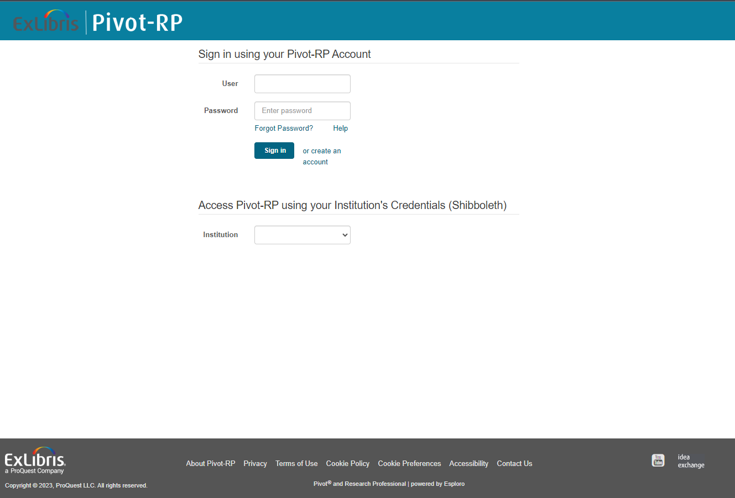
Setting Up Your Account
Logged in on your computer, go to ospa.siu.edu, click on the PIVOT quicklink on the right, and click on the pivot.proquest.com link. That will take you here:

Slide 7
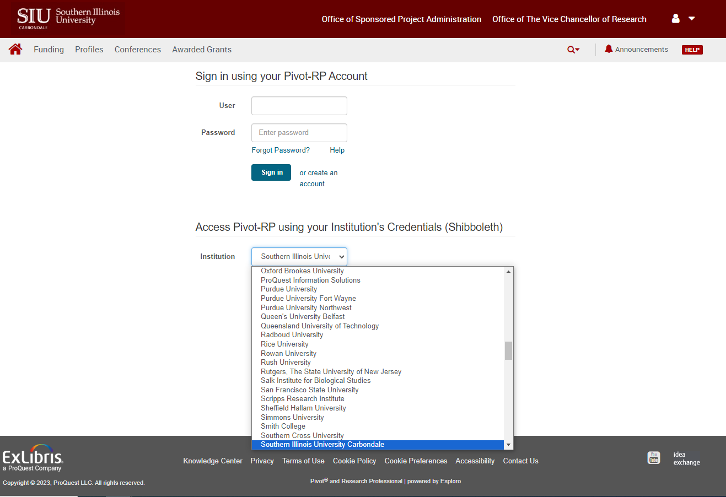
Setting Up Your Account
Select Southern Illinois University Carbondale from the Institution dropdown menu:

Slide 8
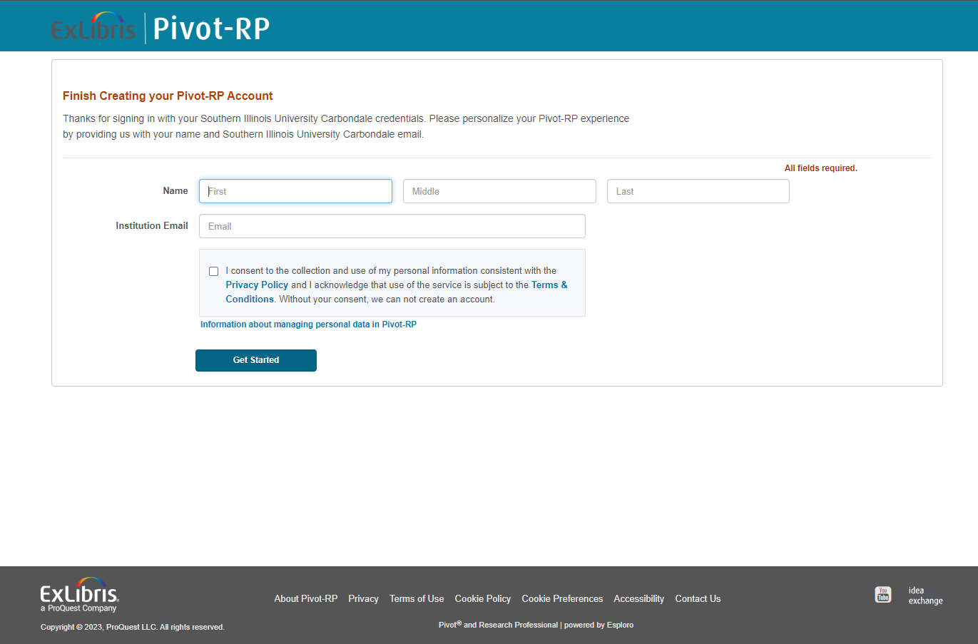
Setting Up Your Account
Finish creating your account: enter your name and institution email, check the box and click Get Started:

Slide 9
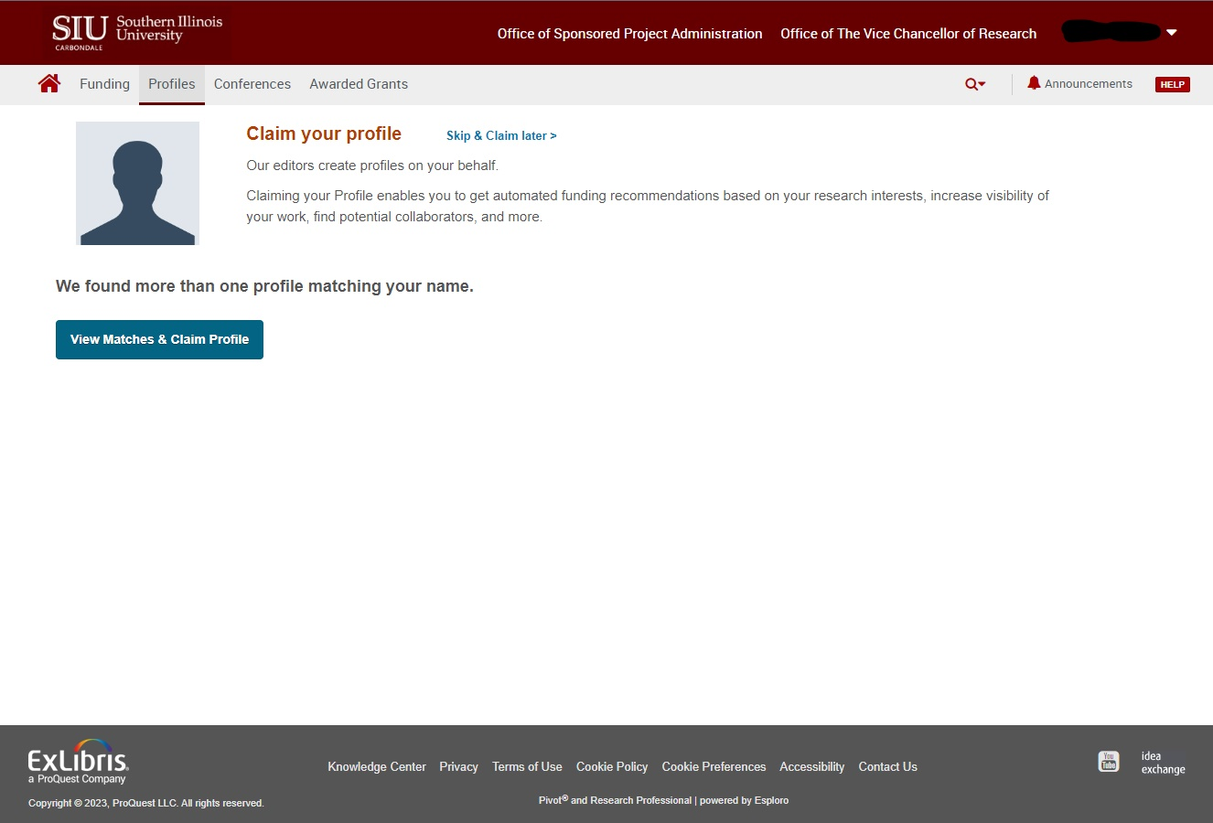
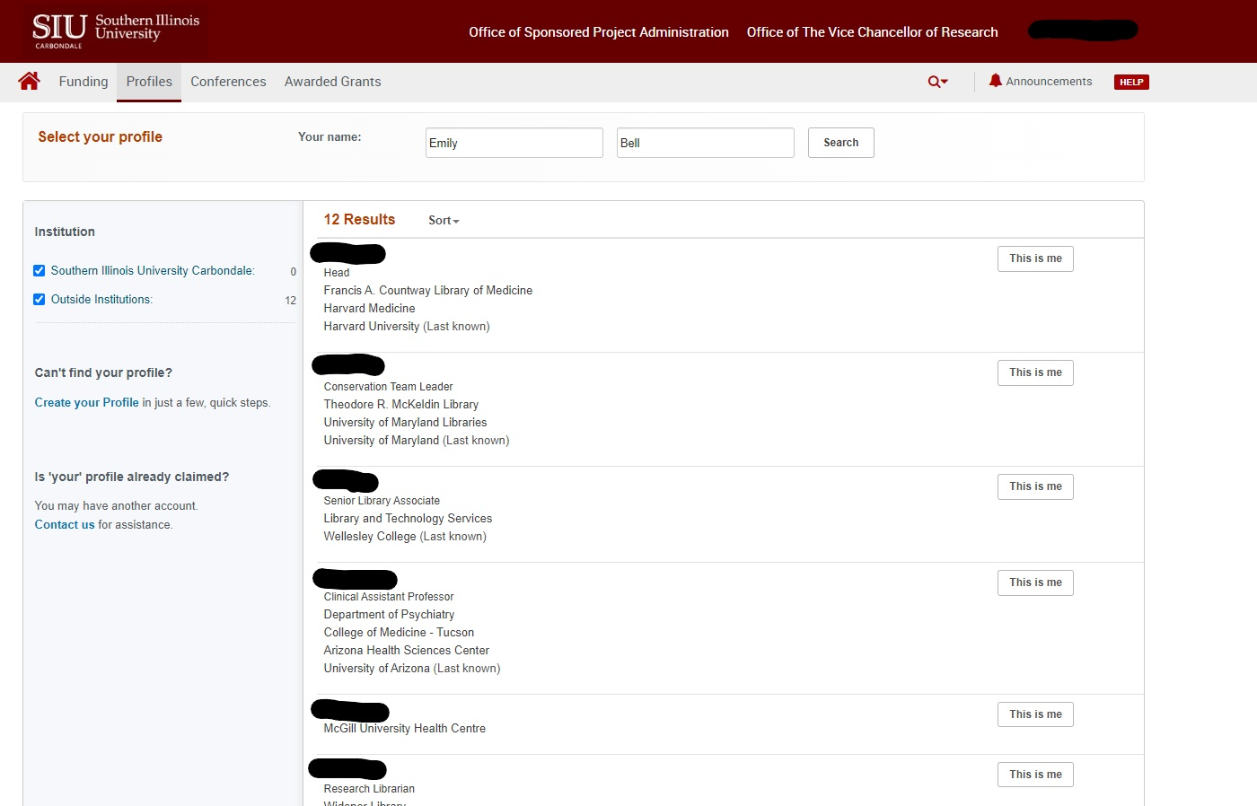
Claiming or Creating Your Profile
There may already be a matching profile—view to claim a profile.
If none of the matches is actually you, click on Create your Profile:

Slide 10
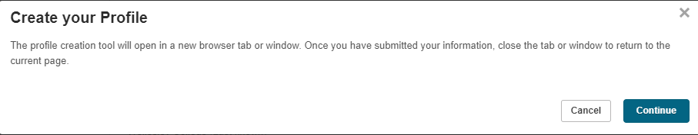
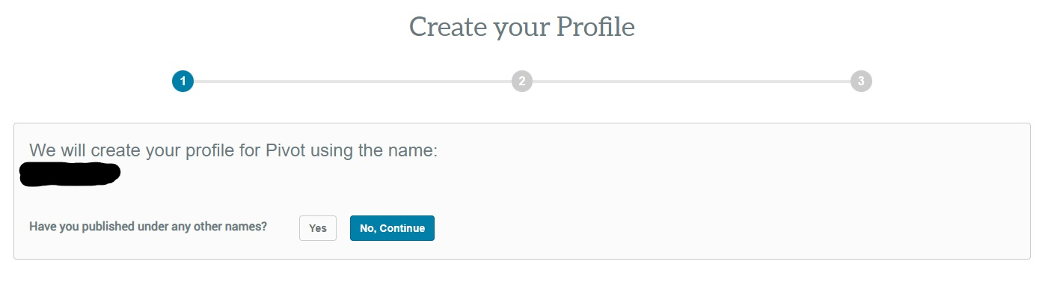
Claiming or Creating Your Profile
Clicking on Create Your Profile prompts a pop-up series:
1
2/3

Slide 11
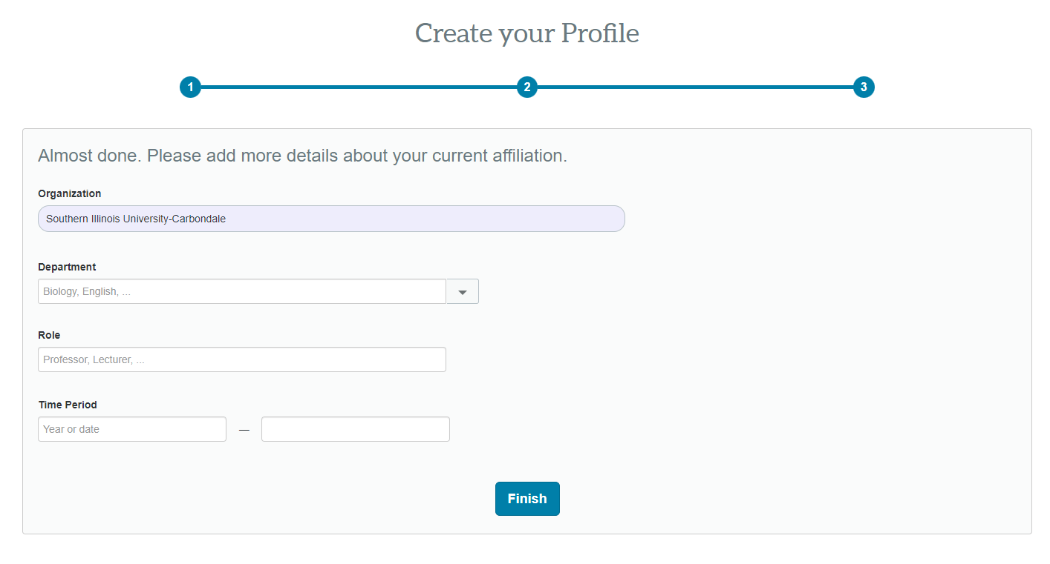
Claiming or Creating Your Profile
Add a few details and click Finish:

Slide 12
Pivot Questions?

Slide 13
Ready to Apply for Funding?
Identify a Grant Opportunity
  PIVOT
  Grants.gov
Confirm Eligibility
  Who can be a PI?
  PI and Institution
  Limited Submission Programs
Submit Proposal Notification
  Via OSPA website

Slide 14
OSPA Deadlines
Deadlines
Deadline | Proposal Documents
As soon as possible (at least 3 weeks prior to sponsor deadline) | Submit your proposal notification on the OSPA website
10 Business Days (prior to sponsor deadline) | OSPA Budget, Budget Justification, Brief Description of Work, Subaward Budget, Cost Share Form
5 Business Days (prior to sponsor deadline) | Subaward Package, Senior Personnel Documents, Completed Budget in Sponsor Format/Portal, Approved Cost Share Form
3 Business Days (prior to sponsor deadline) | Proposal Checklist, FCOI for all SIU Personnel, Project Description, Remaining sponsor-required documents
1 Business Day (8 a.m. the day before sponsor deadline) | Finalized full proposal in sponsor-required format/portal
Note: Our office cannot guarantee submission unless all required documents are received in the office three business days
prior to the submission deadline.

Slide 15
Required Internal Forms
Forms available for download from our website
Institutional Information
Helpful information for completing sponsor application forms

Slide 16
Budget Preparation
The budget is essentially your scope of work expressed in numerical format.
Every proposal requires a budget and budget justification, using OSPA’s templates.
Roles:
  PI prepares draft budget
  OSPA Review:
    Check budget periods, salary, and rates
    Confirm costs are allowable, allocable, and reasonable

Slide 17
Preparing Proposal Documents
Utilize the solicitation (e.g.,RFP) as your guide
Be sure to check the review criteria
Ensure the objectives and budget are in alignment
Become familiar with the Sponsor's online portal (if applicable)
  Work with your OSPA representative for any required registrations

Slide 18
Proposal Documents
Required Internal Documents:
  Proposal Checklist (routing form)
  Budget and Budget Justification – OSPA templates
  Scope of work (abstract)
Proposal documents will vary by sponsor, standard requirements:
  Budget and Budget Justification in sponsor required format
  Narrative / Scope of Work
  Facilities and Equipment
  Senior personnel documents (biosketch, current & pending support, etc.)

Slide 19
Internal Approvals – Proposal Checklist
It is the PI's responsibility to route the checklist for signatures within their School/College.
Signatures required involve: PI & Co-PI, Senior Personnel, Fiscal Officer, School Director (or equivalent) & Dean (or equivalent)
OSPA requires the signed checklist three full business days before deadline.

Slide 20
Additional Considerations
There are some aspects of proposal preparation that require additional time/materials:
  Inclusion of a subrecipient
  Cost share
  Reduction of F&A request
  Compliance concerns

Slide 21
Who Submits?
Long story short… it depends!
Bottom line is all proposals, whether it’s electronic or hard copy, OSPA submission or PI submission, OSPA reviews and “green-lights” all proposals prior to submission.
Be sure you’re following the internal deadline timetable so we have enough time to review—last minute submissions can overload systems or lead to omissions/errors that could have been prevented.

Slide 22
Award Negotiation & Acceptance
Notice of Award Received (forward to OSPA if sent to PI directly)
OSPA reviews for:
  Dates and Budget are in agreement with the proposal submitted
  Deliverables – both programmatic and financial
  Compliance – IACUC, IRB, FCOI, Export, etc.
  Legal terms – if there are terms in the award agreement that the university cannot accept, OSPA will attempt to negotiate more favorable terms.
OSPA will accept the award on behalf of the university and the PI(s)
If your award includes subrecipients, once the agreement is fully executed, OSPA drafts the subaward and initiates negotiations.

Slide 23
Post-Award Management
Account Setup:
  Once a fully executed agreement (FEC) is received an account (BP) can be established
  Advance account – for awards under negotiation
  Grant Assignee
Modifications – likely require prior approval from the sponsor
  Rebudgeting
  Extensions
  Changes to key personnel or scope of work
Reporting
  Financial (invoices) – OSPA
  Program – PI
  Cash and Revenue Management
  Subrecipient Management
Award Closeout

Slide 24
Questions?

