Slide 1

INTRODUCTION TO FUNDED RESEARCH

Slide 2
WHY RESEARCH?
It is the mission of Doctoral Research Universities
Intellectually exciting; challenging; leads to lifelong learning
Creates credibility with peers
Solves real problems; addresses real issues
Visibility to University reputation, ranking, enrollments, recruiting of faculty and students
Economic development, clinical, commercial, and business opportunities
Research Universities are vibrant, exciting places to learn and teach and work
As faculty you train, educate, and mentor students
  Graduate and undergraduate students engaged in research are better prepared for the workforce and have a higher probability of graduation

Slide 3

HOW TO START RESEARCH AT SIUC?
1. Set up your lab or studio
  Use your start up to purchase and install equipment
2. Hire students
  Talk to your Director of Graduate Studies to get access to applications
    The Grad School has a program to bring the best prospective students to visit campus
    Personal contact matters
  Look to recruit the most talented students from your classes
  The established stipends are minima. Be nationally competitive
  Undergraduate research students can be prepared to join your research in future years
3. Start preparing for your external funding proposals

Slide 4
HOW TO IDENTIFY FUNDING SOURCES
Let’s divide disciplines very broadly:
  Medicine
  STEM
  Social Sciences
  Humanities
  Arts
  Other
Medical research is funded by almost all Federal agencies except NSF
  (Learn abbreviations ☺ )
STEM research is funded by all Federal Agencies
Social Science research is funded primarily by NSF
Humanities and Arts research is funded primarily by the NEH and the NEA
State agencies also fund major research efforts
Foundations (family, private, corporate) and individual donors also fund all research

Slide 5
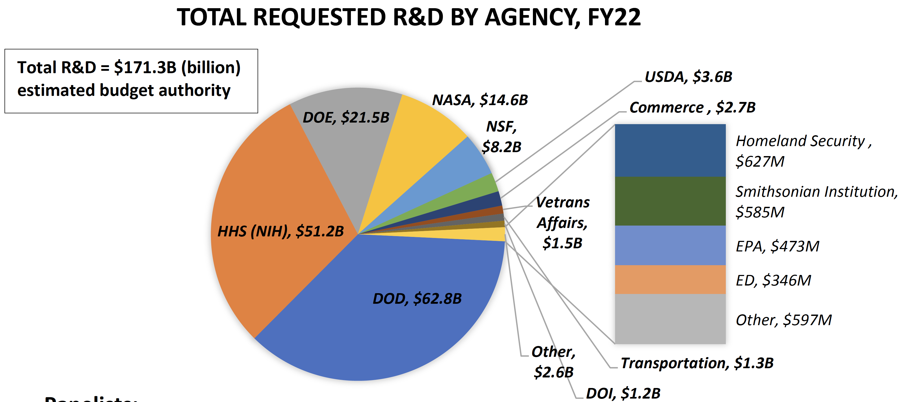

Slide 6
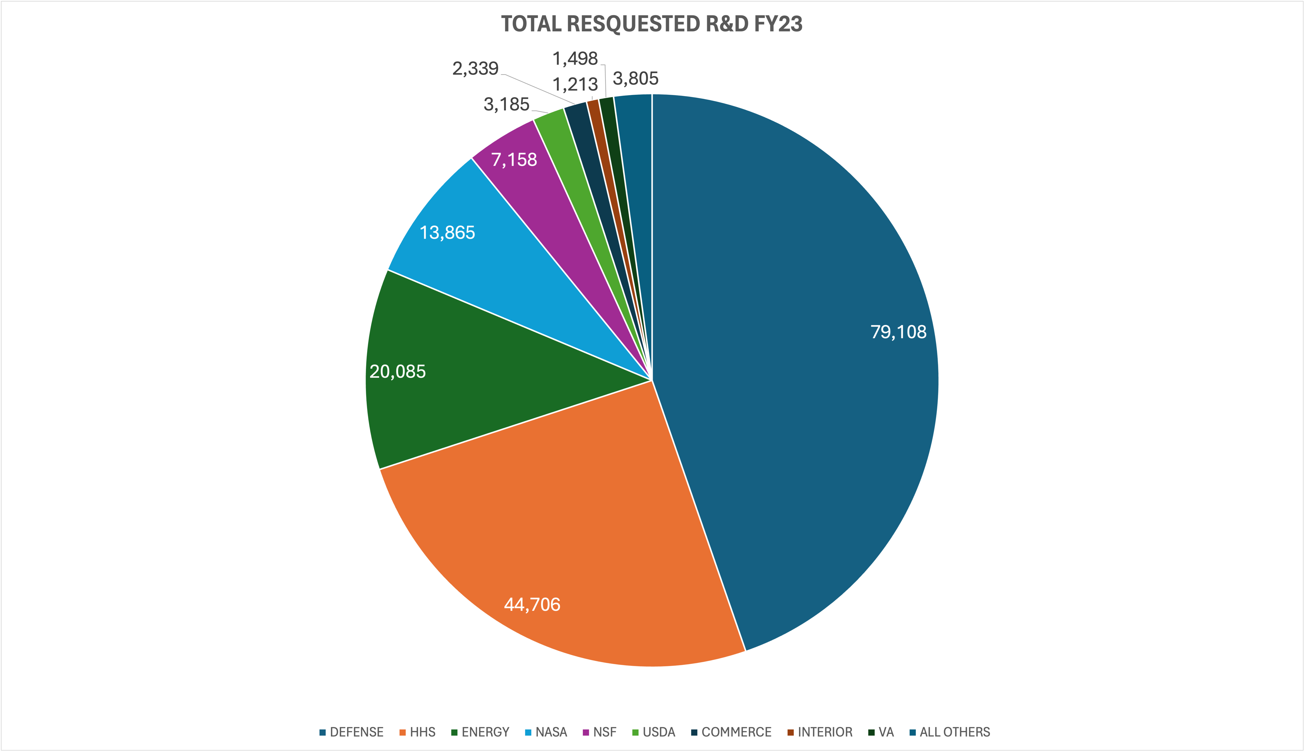
TOTAL REQUESTED R&D FY23

Slide 7
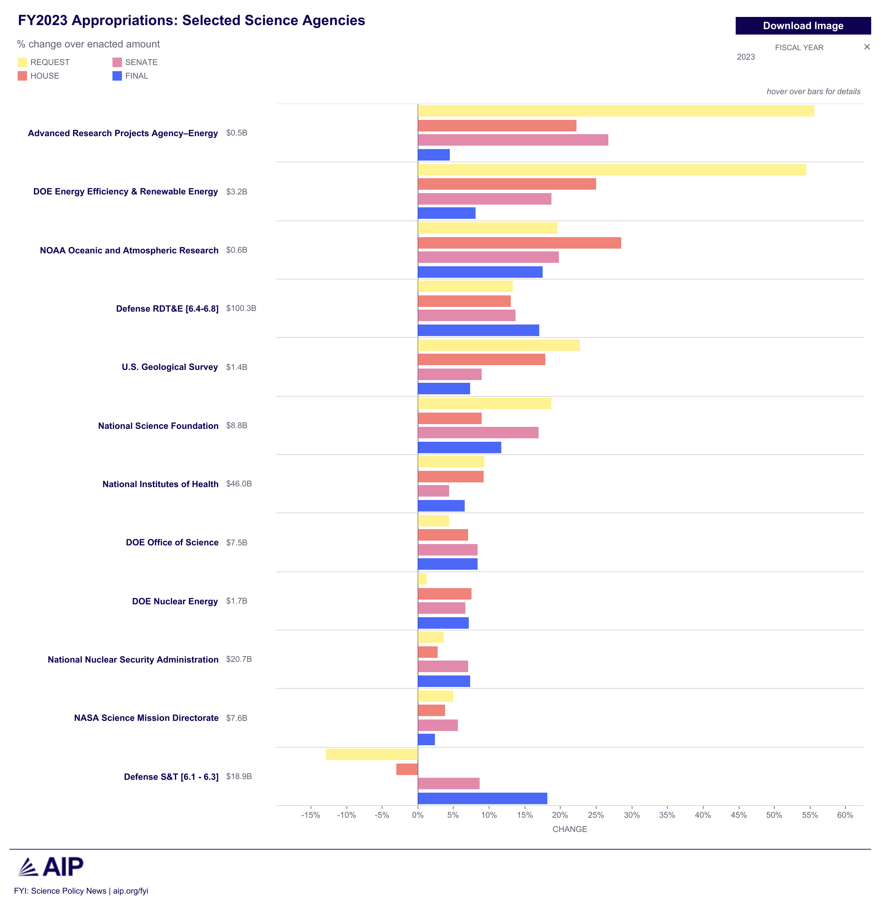

Slide 8
SOME 2023 FUNDING SOURCES
Federal Sources | Industry | State of Illinois | Other
NASA | BASF Corporation | Board Education | Soybean Council
NIH | Constellation Energy | Nat Res | Chicago Botanic Garden
NSF | Arkea Bio | Agriculture | Nature Conservancy
DoE | Bayer | Natural Res | Metro Water Distr SoCal
Army Corps | KBR | Commerce | Green Tech
USDA | Sygenta | Public Health | IN DNR
EPA | Peabody Energy | Transportation | Egyptian Area Agency on Aging
Library of Congress | Research Corp | Human Services | SIH
USDI | IKAV Energy | Arts Counil | IA Workforce dev
VA | Louis Dreyfus Co | Native Plant Soc | LLNL

Slide 9
HOW TO IDENTIFY THE RIGHT AGENCY
Each agency has a mission
  Study the basic mission to understand how your research fits
Each agency has subdivisions (directorates, programs, etc.)
  Identify the ones that fit your research
Each agency has:
  Application deadlines
  Application format, rules, etc.
  Eligibility criteria
  Example: AFOSR YIP
The principal investigator of a proposal must be a U.S. citizen, national or permanent resident, holding a full-time tenure-track or tenure-track-equivalent faculty position, and has received his/her doctorate or equivalent degree by 1 April 2016 or later.
The FY24 Young Investigator Program (YIP) accepts white papers by June 12, 2023, and proposals until August 14, 2023.
Up to $450,000 for 3 years

Slide 10
HOW TO IDENTIFY THE RIGHT AGENCY (ii)
Talk to your colleagues and mentors
Come to our workshops.
  In Spring 2024:
    Proposal writing
    How I learned to be a mentor
    Working with State agencies
    R&D with industry
    Early Career Funding Opportunities
  Planned for Fall 2024:
    Beyond NSF (DOD, NIH, NASA, USGS, DoE, DOT, etc.)
    Types of NSF Grants
    Identifying Funding Opportunities for the Arts and the Humanities
Research Discovery Workshop
  Team building
  Opportunities for all disciplines
My office sends out major research opportunities to build teams
PIVOT

Slide 11
HOW TO IDENTIFY THE RIGHT AGENCY (iii)
Funding Agencies want to spend their funds
  This is their mission description: use the funds to support research, development, and creative activities
But sometimes it is hard to find out where to apply
https://grants.nih.gov/funding/searchguide/index.html#/
Now what??
  Come to our workshops
  Talk to your colleagues and mentors
  Talk to the Program Managers / Program Directors

Slide 12
MAKING CONNECTIONS
What is on an RFP/BAA/FFO/etc. is not always 100% what an agency is looking for or it can be unclear or confusing
The PD/PM knows for sure
Reach out to them to learn
How?
  Every program needs reviewers. Send a 2 page CV volunteering to be a reviewer and panelist
    You will find out very quickly if you fit the Directorate’s mission
    You have built ONE connection
  Write a 2 page white paper describing your research idea and email it
    You may get feedback. SECOND connection
      Some agencies are better than others in responding. So are some PMs ☺
  Ask the PM for a meeting to learn about the agency and to present your ideas
    Could be remote or in person. THIRD connection
  Respond to RFIs
    These are not as often, but worthwhile. PIVOT can track for you. FOURTH connection.
  Take advantage of all opportunities to connect with industry, government labs, companies
    Be part of SIU’s TIE, visits to Argonne, talks by industry, and -of course- our workshops

Slide 13
MAKING A GOOD IMPRESSION
Keep your web site current
  Put links to your vita and publications!
When contacting agencies be prepared
  Do your research
  Know your elevator speech
  If you give us your white papers this Spring semester expert reviewers will comment on them
  Listen, listen, listen
  Offer to review proposals

Slide 14
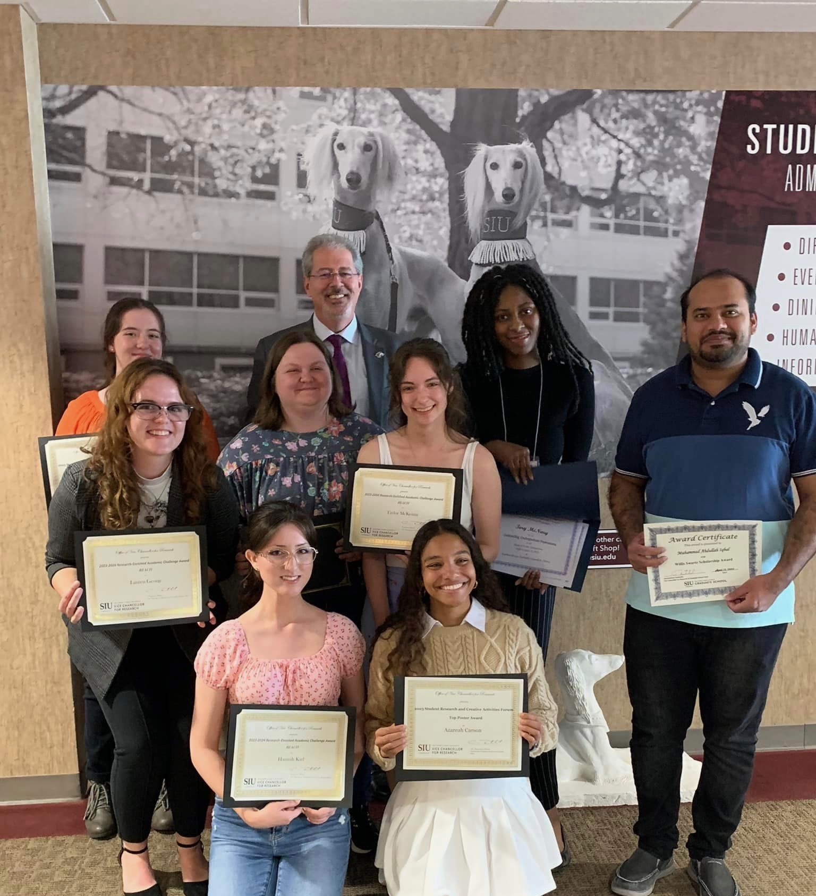
INTERNAL SUPPORT
Starting a research career is not easy. We are here to help:
  OSPA
  Compliance
Proposal mentor team
Research Centers
Seed grants
  SIU System to build collaborations with SoM
  Meyer Research Center
  Advanced Energy Institute
  Proposal Development Support
  SIU Foundation
Student research support
  REACH
  Fellowships
Workshops, Research Discovery, Creative Activities and Research Presentations (CARP), Graduate Student Research Forum, Professional Development for Graduate Students, Conference Travel Support for Faculty, Support to Visit Funding Agencies

Slide 15


