Slide 1
Office of Sponsored Projects Administration

Slide 2
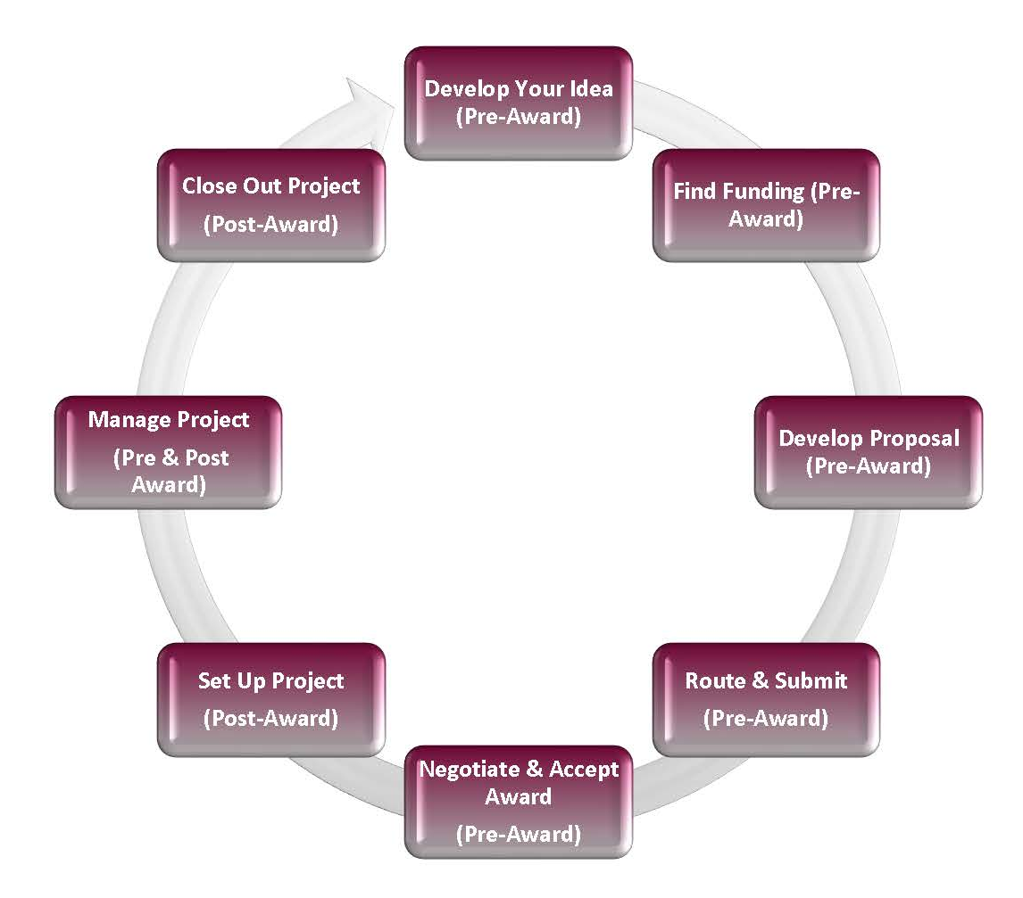
About Us
OSPA is a unit of the Office of the Vice Chancellor for Research
OSPA’s mission: facilitate, support and advance research efforts
OSPA is the campus unit designated to submit grant proposals and accept awards on behalf of the university
OSPA provides oversight to ensure sponsored activities comply with federal, state and university policies and regulations
Notes:
OSPA is a unit of the VCR - primary mission is to support the research efforts of the University while ensuring activities comply with federal, state and university regulations.
OSPA consists of two teams – Pre-Award and Post-Award
OSPA is the central unit responsible for the submission of grant proposals and acceptance of awards on behalf of the university
OSPA is here to assist you in every step of the sponsored projects lifecycle – from providing tools to identify funding through closeout. Today we will be highlighting key items from the lifecycle that will assist your pursuit for external funding.

Slide 3
Services Provided by OSPA
Assist in finding funding opportunities
Facilitate and guide proposal development, budget preparation, etc.
Review, approve and submit proposals
Negotiate and accept awards
Post-Award Administration:
  Account Setup
  Cash and Revenue Management
  Subrecipient Management
  Award Modifications
  Award Closeout
Manage grant audits (internal and external)
Notes:
OSPA provides a number of key services throughout the lifecycle of sponsored projects. Today we will primarily focus on finding funding and proposal submission.

Slide 4
Pivot-RP Overview
  What is it?
    Subscription service provided by OVCR to all SIUC faculty, staff, and students
    Database of assistance opportunities and potential collaborators
  Set up your account
  Claim your profile
Notes:
Kelly
Pivot is a database of assistance opportunities and potential collaborators, a subscription service provided by the Vice Chancellor for Research available to all SIUC faculty, staff, and students. Say you’re a new investigator or you’re going in a new direction and would like to find someone who already has expertise in that area—you can find someone in Pivot to reach out to, whether within SIU or anywhere in the world.
The website also allows users to set up automated funding alerts specifically tailored to your areas of interest so it makes it even easier to find those opportunities, without even having to continually search.

Slide 5
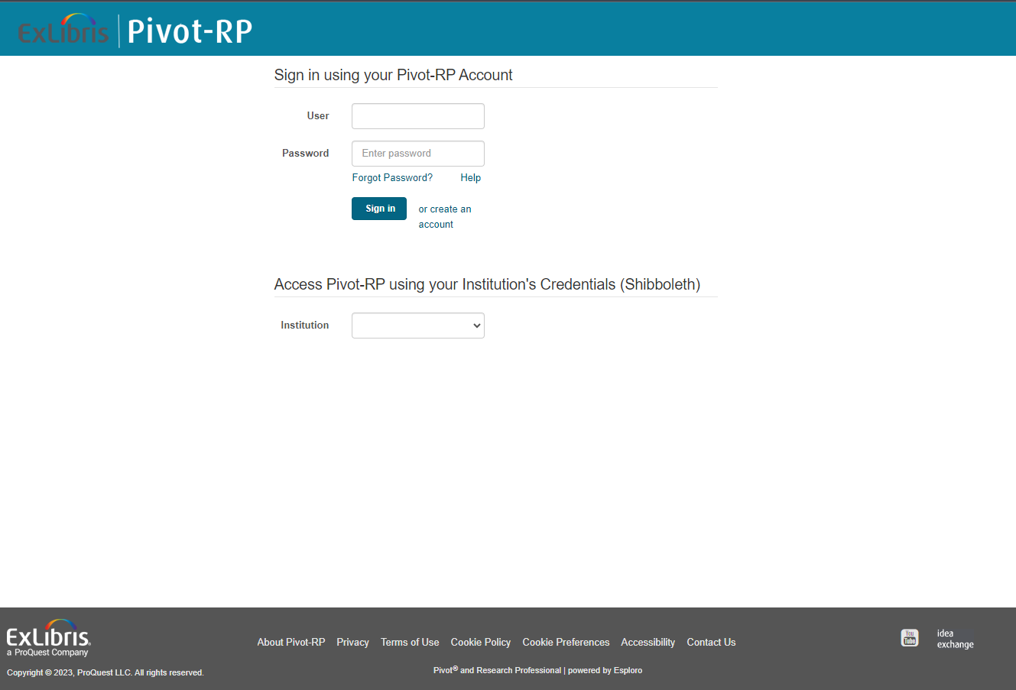
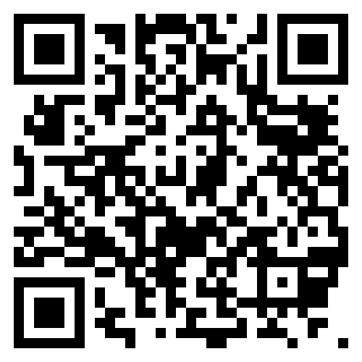
Setting Up Your Account
Logged in on your computer, go to ospa.siu.edu, click on the PIVOT quicklink on the right, and click on the pivot.proquest.com link. That will take you here:

Slide 6
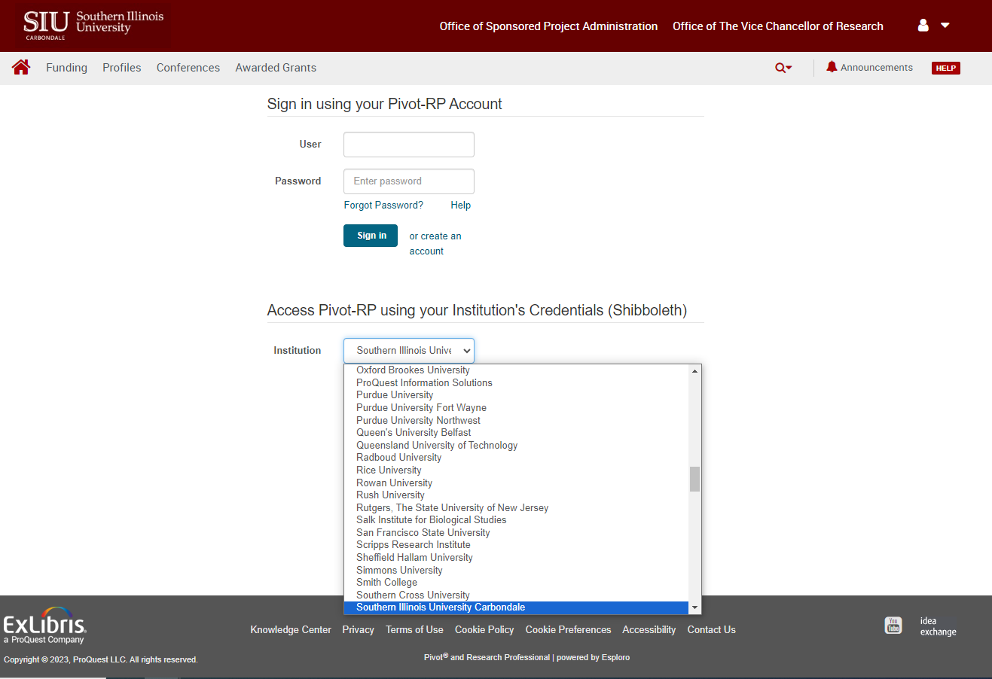
Setting Up Your Account
Select Southern Illinois University Carbondale from the Institution dropdown menu:
Notes:
You should be redirected to the SSO page; enter your credentials

Slide 7
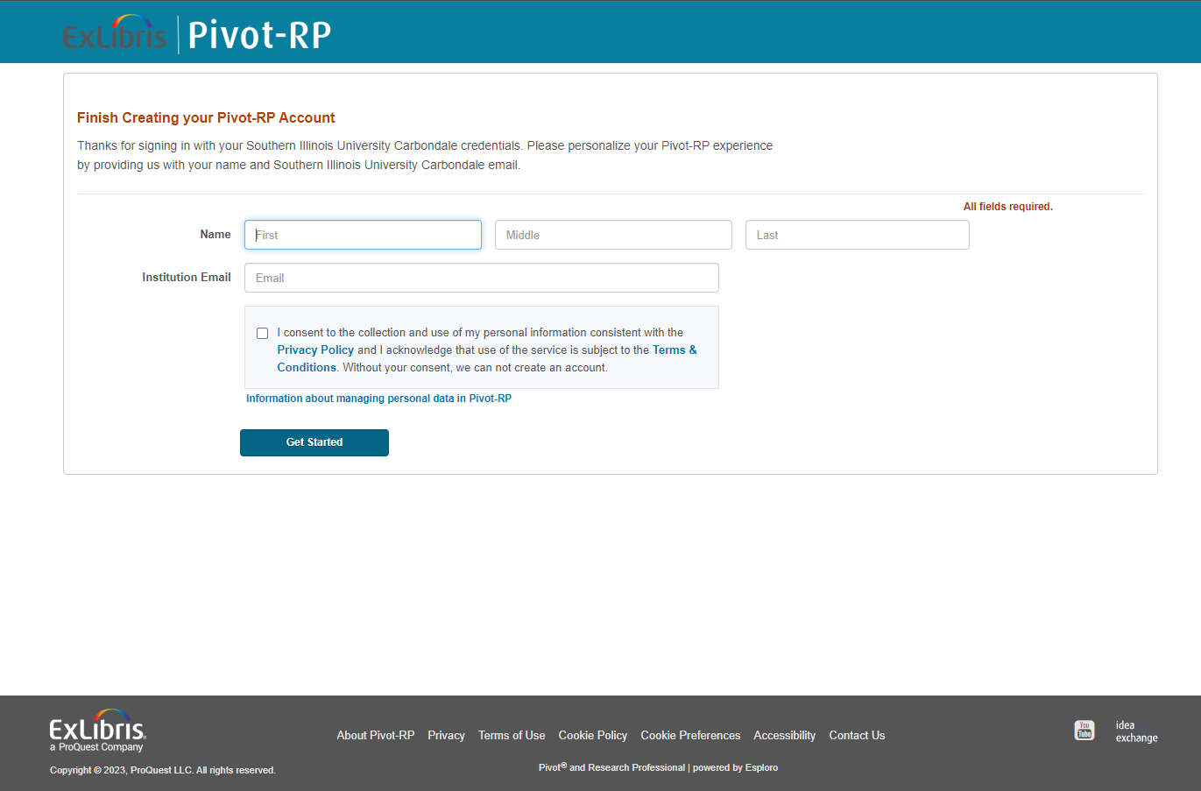
Setting Up Your Account
Finish creating your account: enter your name and institution email, check the box and click Get Started:
Notes:
Pivot will send an email to validate and activate your account

Slide 8
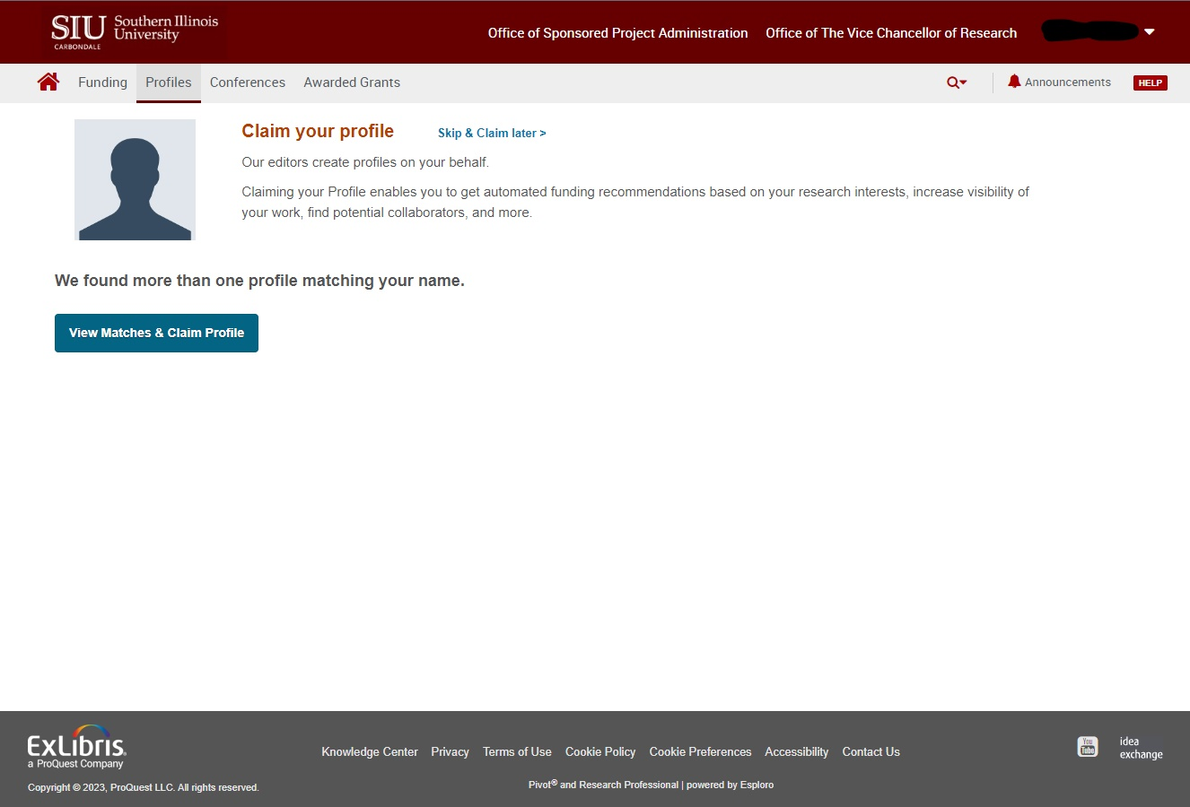
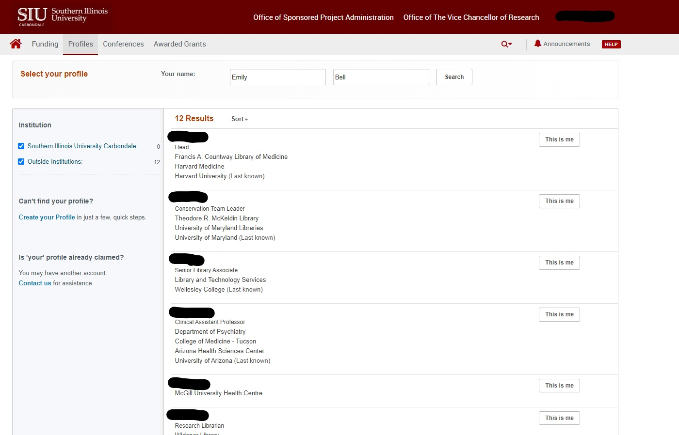
Claiming or Creating Your Profile
There may already be a matching profile—view to claim a profile.
If none of the matches is actually you, click on Create your Profile:
Notes:
Upon logging in, Pivot will prompt you to claim your profile. There may be profiles matched to you– view the matches and see if any of them are you, because it can bring in prior data. Otherwise, click on create your profile. Claiming/creating your profile allows Pivot to match you with funding opportunities and with collaborators based on the information that you provide

Slide 9
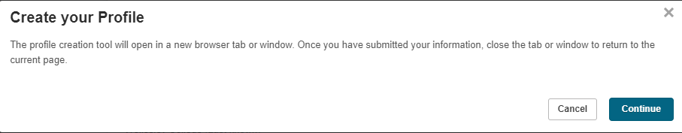
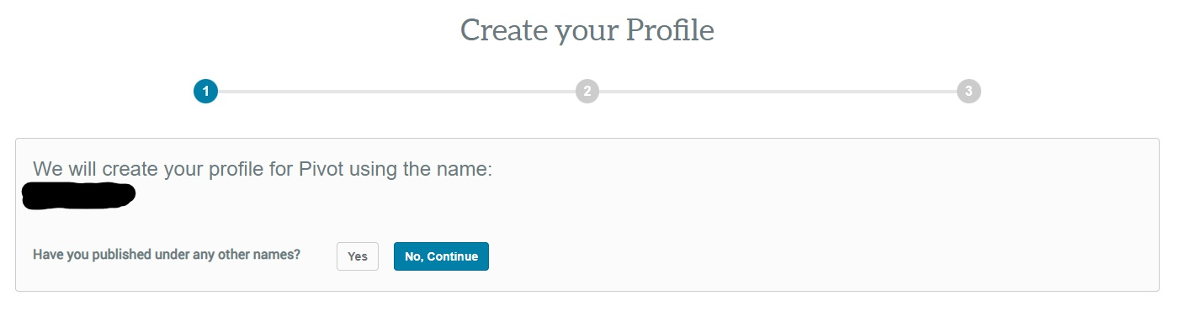
Claiming or Creating Your Profile
Clicking on Create Your Profile prompts a pop-up series:
1
2/3
Notes:
Click continue, will open in a new tab/window, will ask if you’ve published under any other names and if you use any other email addresses.

Slide 10
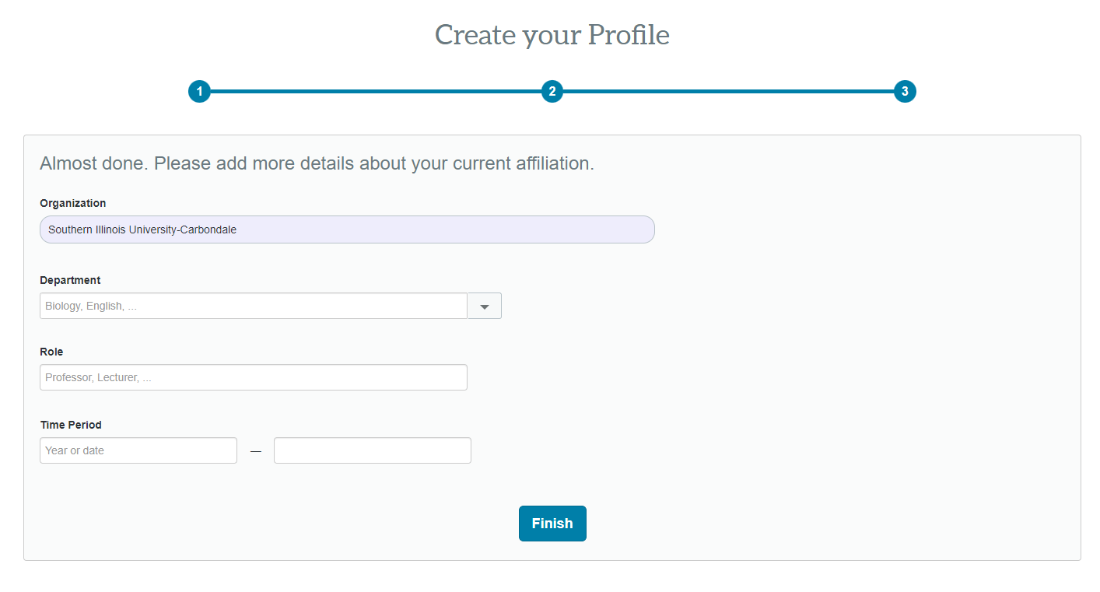
Claiming or Creating Your Profile
Add a few details and click Finish:
Notes:
Clicking finish will take you back to your original tab, directly to your profile in Pivot. Take a few minutes and add a few details to your profile—this will enhance Pivot’s ability to tailor funding opportunity recommendations to you. You can always edit or add more later as well.
Switch to browser

Slide 11
Ready to Apply for Funding?
Identify a Grant Opportunity
  PIVOT
  Grants.gov
Confirm Eligibility
  Who can be a PI?
  PI and Institution
  Limited Submission Programs
Submit Proposal Intake Form
  Via OSPA website
Notes:
Beth
Grants.gov is a great quick place to search for federal grant opportunities. The site has a basic search and advanced filters. Make sure you're using the most recent version of a solicitation by finding it in grants.gov.
Eligibility – most likely all of you qualify under Category 1 and are eligible as a PI. If you will be working with others, please check the list on our website to see who is eligible to serve as a PI.
Review the RFP/solicitation carefully to ensure you and SIU are eligible to apply. It is important to do this first, as you don't want to spend time preparing a proposal only to find out later that you can't apply. For example, some solicitations are specific to the number of years past your terminal degree. Sometimes there are limited submissions – where only 1 or a few proposals may be submitted by the University. In this case, we have an internal process to determine who from SIU can apply. Our website has more information.
Once you've decided to apply, you should notify our office through the proposal notification form that can be accessed from our home page. Please submit this notice at least 3 weeks before the sponsor deadline. You will receive an auto-confirmation that your notification was received and within 2 days you will be assigned to an OSPA team member who will email you to get started on the process, letting you know what is needed.

Slide 12
OSPA Deadlines & Required Documents
Deadlines
Deadline | Proposal Documents
As soon as possible (at least 3 weeks prior to sponsor deadline) | Submit your proposal notification on the OSPA website
10 Business Days (prior to sponsor deadline) | OSPA Budget, Budget Justification, Brief Description of Work, Subaward Budget, Cost Share Form
5 Business Days (prior to sponsor deadline) | Subaward Package, Senior Personnel Documents, Completed Budget in Sponsor Format/Portal, Approved Cost Share Form
3 Business Days (prior to sponsor deadline) | Proposal Checklist, FCOI for all SIU Personnel, Project Description, Remaining sponsor-required documents
1 Business Day (8 a.m. the day before sponsor deadline) | Finalized full proposal in sponsor-required format/portal
Note: Our office cannot guarantee submission unless all required documents are received in the office three business days
prior to the submission deadline.
Notes:
Beth
These deadlines are listed on our website. Some documents like subawards and cost share may not apply to your proposal.
It is critical to adhere to these deadlines as it will allow our team to balance our workload and ensure that all proposals get a full review. Last minute submissions can overload sponsor submission systems or lead to omissions/errors that could have been prevented.
Note: Our office cannot guarantee submission unless all required documents are received in the office three business days prior to the submission deadline.
At minimum the listed Internal OSPA documents are required. However depending on the specifics of a proposal, there could be more forms required. Your OSPA Representative will guide you on any other additional forms that may be needed.

Slide 13
Required Internal Forms
Forms available for download from our website
The OSPA Proposal Checklist is the internal final approval to submit. It is the PI's responsibility to route the checklist for signatures within their School/College.
Institutional Information
Helpful information for completing sponsor application forms
Notes:
Beth
Previous slides refer to many documents that are part of a proposal package. Several of them are internal to OSPA and those can be found on our website. (Show where forms are located on the website and brief overview of what's available.)
Note that there will be sponsor-required documents and formats as well, but that the OSPA internal documents are always required.
Our Institutional Information is available on the website and it's a very helpful reference tool as you complete sponsor applications. (go to webpage to show what is available)

Slide 14
Budget Preparation
Every proposal requires a budget and budget justification, using OSPA’s templates.
Budgets include Direct and Indirect costs. SIUC has federally negotiated indirect cost rates; these can vary depending on the type of proposal. Work with your OSPA representative to determine the correct rate.
The OSPA website has helpful information Budget Categories and Budget Rates.
Notes:
Rachel
PI prepares the budget and OSPA reviews it. SIU has federally negotiated indirect cost rates. We must use these rates, though there are very rare occasions when a different rate could be used. Work with your OSPA representative to determine the correct rate.
Emphasize that when they begin to create the budget, they should refer to the links for more information on budget categories and budget rates. Download new forms for every proposal as rates are updated.

Slide 15
Additional Considerations
There are some aspects of proposal preparation that require additional time/materials:
  Inclusion of a subrecipient
  Cost share
  Compliance concerns
Notes:
Rachel
A subrecipient or subawardee is another organization that will be responsible for carrying out a portion of the scope of work. We would require at the minimum a detailed budget and justification in the sponsor’s format, scope of work, and commitment form from the organization—your OSPA representative will assist you in determining whether a collaborator would be included as a subrecipient or other participant, and what additional documentation will be required.
Cost share refers to any costs committed to a project that are not covered by the sponsor. There are several different types of cost share—mandatory, voluntary, and uncommitted. Some cost shared items would require our cost share request form—this is detailed on our website under Pre-Award, Budget Preparation, and again your OSPA representative will advise you on whether additional documentation would be required.
Compliance refers to things like human subjects research, vertebrate animals research, etc. which Sarah and her group will talk about in a bit more detail. In most instances, compliance approvals will not be required at the time of proposal submission, but need to be indicated on the proposal checklist in the event it is awarded so we can coordinate with the appropriate parties.

Slide 16
Who Submits?
Long story short… it depends!
Bottom line is all proposals, whether it’s electronic or hard copy, OSPA submission or PI submission, OSPA reviews and “green-lights” all proposals prior to submission.
Notes:
Rachel
Sometimes it is more appropriate for PIs to submit—some sponsors have their own portals where proposal details are entered manually. In those types of cases, we would request login info or a PDF of the portal information to review prior to submission.
Most federal proposals, our office submits, but the PI has their own account—your OSPA representative will assist you with getting an account set up if you do not already have one. Please keep in mind setting up an account may take time, so begin the process early. Make sure to adhere to our deadlines discussed earlier.

Slide 17
Award Negotiation & Acceptance
Notice of Award Received (forward to OSPA if sent to PI directly)
OSPA reviews for:
  Dates and Budget are in agreement with the proposal submitted
  Deliverables – both programmatic and financial
  Compliance – IACUC, IRB, FCOI, Export, etc.
  Legal terms – if there are terms in the award agreement that the university cannot accept, OSPA will attempt to negotiate more favorable terms.
OSPA will accept the award on behalf of the university and the PI(s)
Notes:
Kelly
Congratulations your proposal was funded! OSPA should receive the Notice of Award – if you receive it directly please forward to our office.
The Pre-Award team will review the award for all business matters (dates, budget, deliverables), compliance concerns (IACUC, IRB, etc.), and legal terms. The review process can often involve several units on campus (ORC, TT, Export) we do our very best to minimize any delays but sometimes they are unavoidable depending on the project.
We do try to negotiate more favorable terms, but in some cases review by legal counsel is required
Proposals that are complete and that have been fully reviewed by OSPA, generally take the least amount of time to setup.

Slide 18
Post-Award Management
Account Setup:
  Once a fully executed agreement (FEC) is received an account (BP) can be established
  All compliance approvals must be in place before the PI will have access to funds
  Advance account
Modifications
  Rebudgeting
  Extensions
  Changes to key personnel or scope of work
Reporting
Closeout
Notes:
Once the agreement is fully executed the Pre-Award team will request an account or Budget Purpose be established. A BP is a restricted funds account designated for this activity and this activity only.
It is important to note that all compliance approvals must be in place before a Budget Purpose can be requested.
If negotiations are lengthy there is an option to establish an advance account, see our forms page for more guidance.
For modifications such as rebudgeting requiring program approval, no cost extensions, or changes to KP or SOW, your first contact should be your post-award contact; they can determine what will be needed and if pre and post need to collaborate on the mod
Similar to proposals you will be assigned to work with a specific member of our post-award team for the financial management of your project. Along with the BP, you are assigned a post-award contact/accountant. This person will review the account expenditures to ensure they’re allowable, allocable, and reasonable, monitor spending, submit invoices/financial reporting to sponsor, as well as closeout. As with proposals there are strict deadlines that must be followed when accepting sponsored funding, especially federal funds. It is critical that you are aware of the deadlines and assist our office in meeting sponsor requirements; please review your award carefully for these requirements

Slide 19
Coming Soon – Kuali Research
Kuali Research – cloud-based, research administration
  Proposal Development
    Construct and route proposals for approval and submission
  Institutional Proposal
    Record of all submitted proposals
  Award
    Record of all funded awards
Notes:
OSPA will be rolling out Kuali Research in FY25 – Kuali is a cloud based, research administration software tool.
PIs will have access to three modules within Kuali: Proposal Development; Institutional Proposal, and Award. Please be on the lookout for emails from our office regarding important dates and training. If you would like to be included in the user acceptance phase, please reach out to ospa@siu.edu or let us know after today’s session.

Slide 20
Questions?
Notes:
Today’s session was intended to provide you what you need to get started, if you have identified a funding opportunity, we do encourage you to scheduled a 1:1 with a Pre-Award specialist for your first submission. Are there any questions related to proposal submission or Pivot?
Thank you for joining today and please be on the lookout for future training sessions offered by OSPA.

