Slide 1

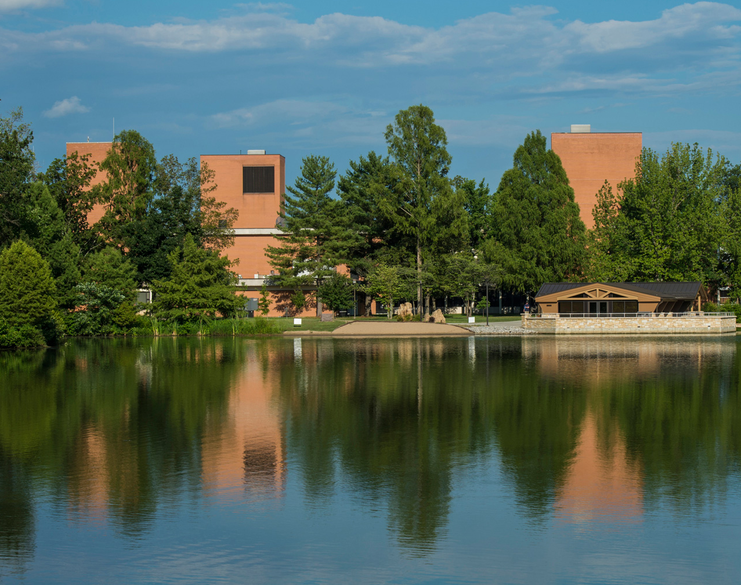
INTRO TO THE OFFICE OF THE VICE CHANCELLOR FOR RESEARCH
Date: Wednesday, September 4, 2024​
Time: 9:00 am – 11:00 am​
Location: Student Services Building Room 150-160​

Slide 2
Office of the Vice Chancellor For Research
(and dean of the graduate school)

Slide 3
Vice Chancellor for Research and Graduate School Dean
Administrative
Aide
Business/Administrative
Associate
Associate Dean and Director of the Graduate School
Director, Office of Research Compliance
Director, Office of Sponsored Programs Administration
Executive Director, SIU Research Park and Office of Innovation and Economic Development
Director, Center for Fisheries, Aquaculture, and Aquatic Sciences
Director, Advanced Energy Institute
Director, Center for Wildlife Sustainability Research
Director, Materials Technology Center
Director, Meyers Institute for Interdisciplinary Research in Organic and Medicinal Chemistry
Director, Southern Illinois Cannabis Science Center
Director, STEM Education Research Center
Director, Mass Spectrometry Facility
Director, Nuclear Magnetic Resonance Facility
Director, IMAGE Center

Slide 4
Faculty Professional Development
Let’s Talk Research last year workshops:
  IRB 101 (x2)
  The 3 Rs in Wildlife Research
  How I learned to be a Mentor: A conversation of faculty experiences in mentoring students (x2)
  Promoting Responsible Research: Data Protection and Cybersecurity Fundamentals
  ORCID and SciENcv
  Grant Writing Fundamentals
  Introduction to Funded Research
  Introduction to R&D Funding through Illinois State Agencies
  Early Career Faculty Research Funding
  Navigating Disclosure Changes

Slide 5
There will be more.

Slide 6
Hanover Research
  The Office of the Vice Chancellor for Research at SIUC has partnered with Hanover Research to provide proposal review and revision services to faculty members seeking external funding.
  Hanover Research has extensive experience supporting both complex multi-PI and individual grants submitted to federal agencies like the National Institutes of Health (NIH) and the National Science Foundation (NSF), as well as private and non-profit foundations. This partnership aims to improve the quality of grant proposals and increase the success rate of funding awards.
We also have a proposal mentor team.
  Faculty who are planning to submit proposals may contact a member for assistance in the preparation of a proposal. The mentor may agree to assist or not depending on their work responsibilities. If the mentor accepts, then they will work with the proposal team to improve the presentation of the work.
We are preparing an October Research Discovery Workshop

Slide 7
Other Services
Replacement, purchase, and repair fund for equipment and facilities
Up to $750 to support faculty to present at conferences - 63 supported last year
Will cover ½ of the costs to visit Funding agencies
Undergraduate research programs
  REACH: Supports 25 students per year
  Susan Thrasher undergraduate research program: Supports 6-10 students per year
Through the Graduate School:
  Almost $850,000 in graduate student fellowships
  Up to $500 for students to present at conferences – 65 supported last year

Slide 8


Q&A Session
Thank you for listening!

