Slide 1

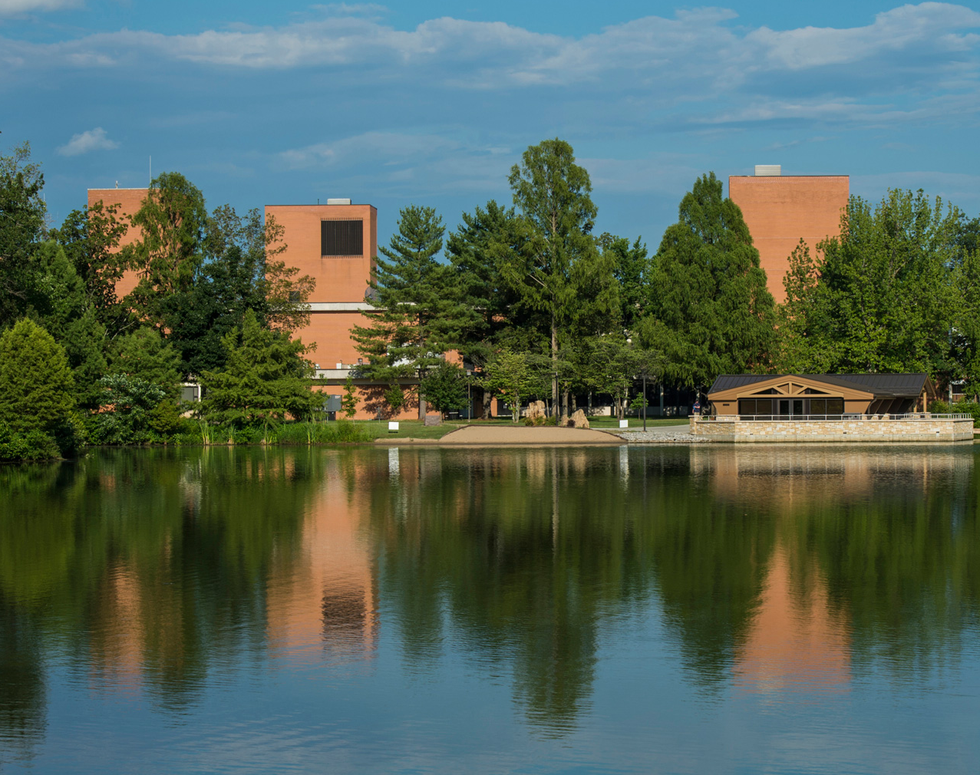
INTRO TO THE OFFICE OF THE VICE CHANCELLOR FOR RESEARCH
Date: Thursday, September 4, 2025

Slide 2
Office of the Vice Chancellor For Research
(and dean of the graduate school)

Slide 4
Faculty Professional Development
Recent Let’s Talk Research workshops:
  IRB 101
  Connecting with Industry and Funding Opportunities: Faculty Experiences
  Beyond the NSF
  Conducting IACUC Required Literature Searches
  HIPAA Research Essentials: Research Data, Authorizations, and the IRB
  Promoting Responsible Research: Data Protection and Cybersecurity Fundamentals
  How I learned to be a Mentor: A conversation of faculty experiences in mentoring students
  Introduction to R&D Funding through Illinois State Agencies
  Early Career Faculty Research Funding
  Navigating Disclosure Changes

Slide 5
There will be more.

Slide 6
Some Services
Replacement, purchase, and repair fund for equipment and facilities
  Over $350,000 spent last year
Up to $750 to support faculty to present at conferences
Will cover ½ of the costs to visit Funding agencies
Proposal mentor team
  Faculty who are planning to submit proposals may contact a member for assistance in the preparation of a proposal. If the mentor accepts, then they will work with the proposal team to improve the presentation of the work.
Undergraduate research programs
  REACH: Supports 25 students per year
  Susan Thrasher undergraduate research program: Supports 6-10 students per year
Through the Graduate School:
  Almost $850,000 in graduate student fellowships
  Up to $500 for students to present at conferences – over 80 supported last year

Slide 7
Seed Funding
Foundation Grant
Collaborative System Grants
Proposal Development Support
From Centers

Slide 8
Shared Facilities and Centers
https://vcresearch.siu.edu/research-support/support-facilities.php
https://vcresearch.siu.edu/research-support/research-centers.php

Slide 9
Upcoming
A “class” on proposal writing
  Details coming next week

Slide 10


Q&A Session
Thank you for listening!

