Slide 1
LET'S TALK RESEARCH
Early Career Research Funding Opportunity Workshop
Office of the Vice Chancellor for Research
Presenter/Date/Info

Slide 2
Panelists
Dr. Senetta Bancroft - Associate Professor, School of Chemical and Biomolecular Sciences and School of Education
Dr. Judy Davie - Associate Professor and Chair, Department of Biomedical Sciences
Dr. Lahiru Jayakody - Assistant Professor, Department of Microbiology
Dr. Gary Kinsel - Professor, School of Chemical and Biomolecular Sciences
Dr. Jia Liu - Associate Professor, School of Civil, Environmental and Infrastructure Engineering

Slide 3
Outline
Office of Naval Research (ONR) - Young Investigator Program (YIP)
Air Force Office of Scientific Research (AFOSR) - Young Investigator Research Program (YIP)
Army’s Research Office (ARO) – Early Career Program (ECP)
Defense Advanced Research Projects Agency (DARPA) - Young Faculty Award (YFA) program
Department of Energy (DOE) - Early Career Research Program
National Aeronautics and Space Administration (NASA) - Early Career Faculty (ECF)
National Institutes of Health (NIH) - Director's New Innovator Award (NIA)
Many others (e.g., USDA, EPA, NIST)
National Science Foundation (NSF) - CRII, ERI, CAREER

Slide 4

ONR YIP
The Office of Naval Research (ONR) Young Investigator Program seeks to identify and support academic scientists and engineers who are in their first or second full-time tenure-track or tenure-track-equivalent academic appointment.
The principal investigator of a proposal must be a U.S. citizen, national or permanent resident (on the date proposals are due), holding a first or second full-time tenure-track or tenure-track-equivalent faculty position, and has received his/her doctorate or equivalent degree within the past seven years.
The Young Investigator Program (YIP) accepts proposals in July
  The solicitation is expected
Up to $750,000 for 3 years

Slide 5

AFOSR YIP
The 2026 Air Force Young Investigator Research Program (YIP) intends to support young in career scientists and engineers who are showing exceptional ability and promise for conducting basic research.
The program objective is to foster creative basic research in science and engineering; enhance early career development of outstanding young investigators; and increase opportunities for the young investigator to recognize the Air Force mission and related challenges in science and engineering..
The principal investigator of a proposal must be a U.S. citizen, national or permanent resident, holding a full-time tenure-track or tenure-track-equivalent faculty position, and has received his/her doctorate or equivalent degree by 1 April 2018 or later.
The FY26 Young Investigator Program (YIP) is expected to be announced on April 25, 2025
  Current Closing Date for Applications: 7 Jul 25 (expected)
Up to $450,000 for 3 years

Slide 6
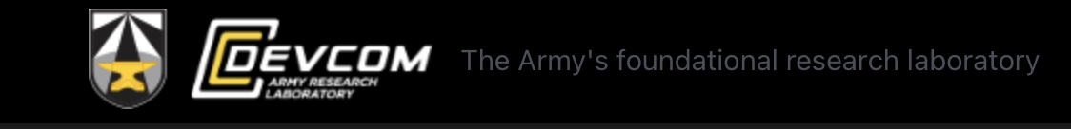
ARO ECP
The Army’s Research Office Early Career Program (ECP) intends to attract outstanding young university faculty members to pursue fundamental research in areas relevant to the Army, to support their research in these areas, and to encourage their teaching and research careers.
Research areas of interest are mechanical sciences, mathematical sciences, electronics, computing science, physics, chemistry, life sciences, materials science, network science, and environmental sciences.
The principal investigator of a proposal must be a U.S. citizen, national or permanent resident, holding a full-time tenure-track or tenure-track-equivalent faculty position.
Proposals are accepted anytime (until 20 November 2027)
Up to $360,000 for 3 years

Slide 7

DARPA YFA
The objective of the DARPA Young Faculty Award (YFA) program is to identify and engage rising stars in junior research positions, emphasizing those without prior DARPA funding, and expose them to DoD needs and DARPA’s program development process
Proposers must be one of the following: current Tenure-Track Assistant/Associate Professors; current Tenured faculty within 3 years of their Tenure date. Citizenship not required.
Engagement with DARPA:
  Each YFA Awardee has a PM Mentor with closely aligned research interests
  The annual meeting provides networking opportunities and presentations from DARPA Technical Offices, military liaisons, and industry representatives
  YFA Awardees have the opportunity to visit military installations, defense- relevant research facilities, or participation in training exercises
  YFA awardees are invited to present their work at Program Review meetings, providing networking opportunities with PMs and other performers
  PM Mentors can nominate YFA Awardees to receive an additional $500K Director’s Fellowship option.
Up to $500,000 for 2 years

Slide 8

Recommendations
Register in SIUC’s PIVOT
Contact program managers: virtually or in person
Attend webinars about specific announcement
Study the FAQs (and submit questions yourselves)
Volunteer to be a reviewer
Respond to RFIs

Slide 9

DoE Early Career Research
Program
The DOE Office of Science is the nation’s largest supporter of basic research in the physical sciences. Early career researchers may apply to one of eight Office of Science program offices: Advanced Scientific Computing Research; Biological and Environmental Research; Basic Energy Sciences; Fusion Energy Sciences; High Energy Physics; Nuclear Physics; Accelerator R&D and Production; and Isotope R&D and Production
To be eligible for the program, a researcher must be an untenured, tenure-track assistant or associate professor at a U.S. academic institution with eligibility window for this competition of 12 years
Pre-applications are mandatory and were due on February 18, 2025. Applications are due on April 23, 2025. Only those applicants that receive notification from DOE encouraging a formal application could submit full applications.
Up to $875,000 for 5 years

Slide 10

NASA ECF
The Early Career Faculty (ECF) component of the Space Technology Program and the ROSES program awards grants to accredited U.S. universities on behalf of outstanding faculty researchers early in their careers.
ECF challenges early career faculty to examine the theoretical feasibility of ideas and approaches that are critical to making science, space travel, and exploration more effective, affordable, and sustainable.
Awards result from successful proposals to the ECF Appendix to the SpaceTech-REDDI NASA Research Announcement. The ECF Appendix is expected to be released annually and will feature specific topics.
The proposed research must be led by a single, eligible principal investigator. The proposed principal investigator must be an untenured assistant professor on the tenure track at the time of award. They must be a U.S. citizen or have lawful status of permanent residency. Co-investigators are not permitted.
Space Technology LOI due in February; proposal due in April
ROSES proposals due January
Up to $600,000 for 3 years
Visit http://nspires.nasaprs.com and/or Grants.gov

Slide 11

NIH Director's New
Innovator Award
NIH’s NIA supports exceptionally creative early career investigators who propose innovative, high-impact projects in the biomedical, behavioral or social sciences within the NIH mission.
Single PI only
Must have completed doctoral degree or postgraduate clinical training within last 10 years and never received a substantial NIH independent research award
No preliminary data required
Minimum of 25% research effort
$1.5 million in direct costs for 2 years

Slide 12
NIH Early Career Awards
K01 – Mentored Research Scientist Development Award
K08 - Mentored Clinical Scientist Research Career Development Award
K23 - Mentored Patient-Oriented Research Career Development Award
An application must include a strong and credible plan for the applicant's transition to research independence, including milestones, and evidence of significant institutional commitment to the continued development of the applicant as an independent researcher at the applicant institution. Applicants are expected to plan to apply for independent research support during the later years of their mentored career award.
By the time of award, the individual must be a citizen or a non-citizen national of the United States or have been lawfully admitted for permanent residence

Slide 13
Many Others
United States Department of Agriculture (USDA), National Institute of Food and Agriculture (NIFA): Agriculture and Food Research Initiative (AFRI)
U.S. Environmental Protection Agency (EPA): Early Career Awards
National Institute of Standards and Technology (NIST)
Currently no details published
  Information available is from before 2022
  Different directorates have different rules and deadlines
    e.g. EPA’s STAR program has “regular” and “early career” award tracks
  Talk to the Program Manager
  Use PIVOT
  Visit Grants.gov

Slide 14

NSF CAREER
CAREER: The Faculty Early Career Development (CAREER) Program supports early-career faculty who have the potential to serve as academic role models in research and education and to lead advances in the mission of their department or organization
Qualifications:
  Hold a doctoral degree by proposal deadline
  Be untenured and employed in an at least 50% tenure-track (or tenure- track-equivalent) assistant professor (or equivalent title) position at an eligible institution as of the annual deadline
  Have both research and educational responsibilities at the eligible institution
  Have not previously received a CAREER award
  Have not had more than two CAREER proposals reviewed previously

Slide 15
NSF CAREER (2)
What makes a CAREER award different:
  All CAREER proposals must have an integrated research and education plan at their core
  Department letter is important:
    Description of how the PI’s career goals and responsibilities mesh with that of the organization and department
    Commitment to the PI’s proposed CAREER research and education activities
    Description of how the department will contribute to the professional development of the PI with mentoring and whatever is needed to further the PI’s efforts to integrate research and education
Proposal deadline: Fourth Wednesday in July (July 23, 2025)

Slide 16
NSF CAREER (3)
NSF offers the following guidance:
  Start early
  Have a mentor evaluate your proposal
  Contact relevant Program Directors to discuss your ideas and seek more information.
  Email the appropriate program director(s) and ask if your research project fits their program
    One-page summary (preferred)
    Your program director can: Confirm program fit; Give advice on common proposal preparation errors; Help you understand the review of a previous proposal; Point you to resources you can use to help write a better proposal next time; Give general guidance on good proposal writing
NSF also advises that you volunteer to be a proposal reviewer
  Important service
  There’s no better way to see how the system works
  There’s no better way to understand what makes a proposal compelling
  Email the program officer of the program your expertise aligns with and include a 2-page NSF biosketch and keywords on your expertise for interest in reviewing

Slide 17
SIUC Research Hub
A Resource for External Funding Opportunities
The SIUC Research Hub is a platform designed to help faculty explore external funding opportunities.
It brings together important information, tutorials, and videos from various federal agencies, along with general SIUC research resources.
The site serves as a complementary tool to assist faculty in identifying funding sources and understanding application processes.
It can only be accessed within SIUC’s network

Slide 18
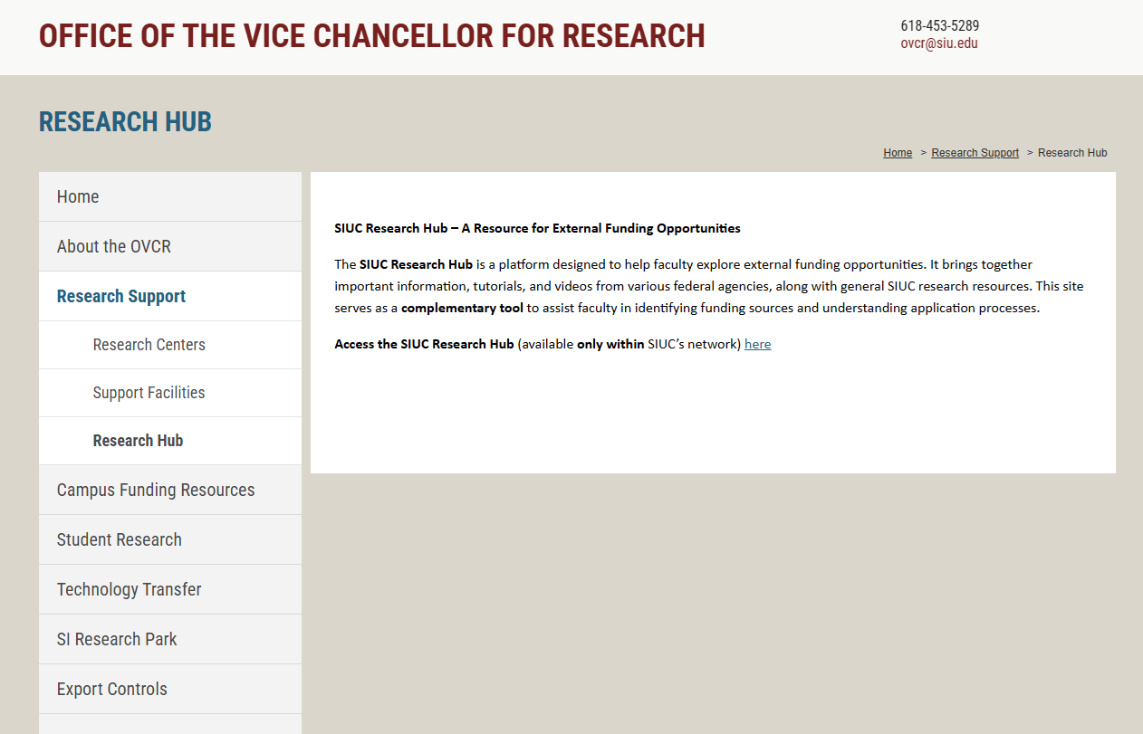
SIUC Research Hub

Slide 19
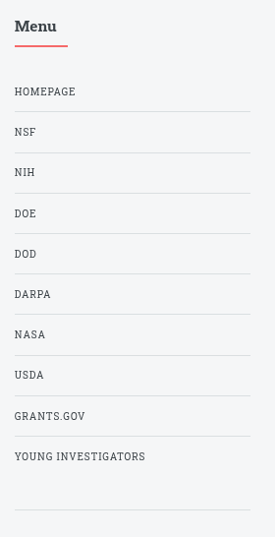
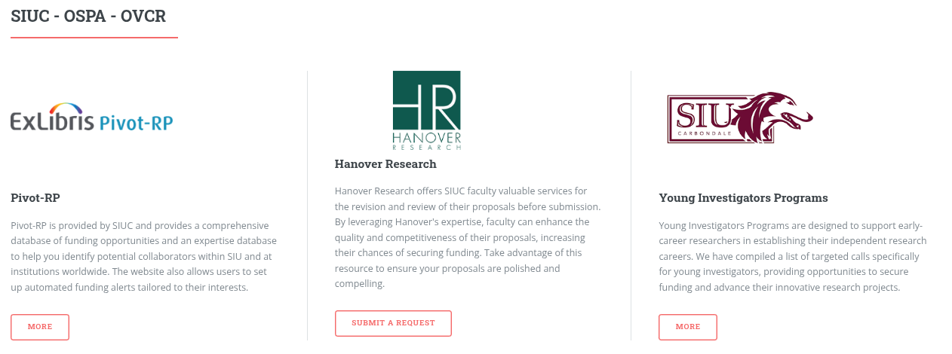
SIUC Research Hub

Slide 20
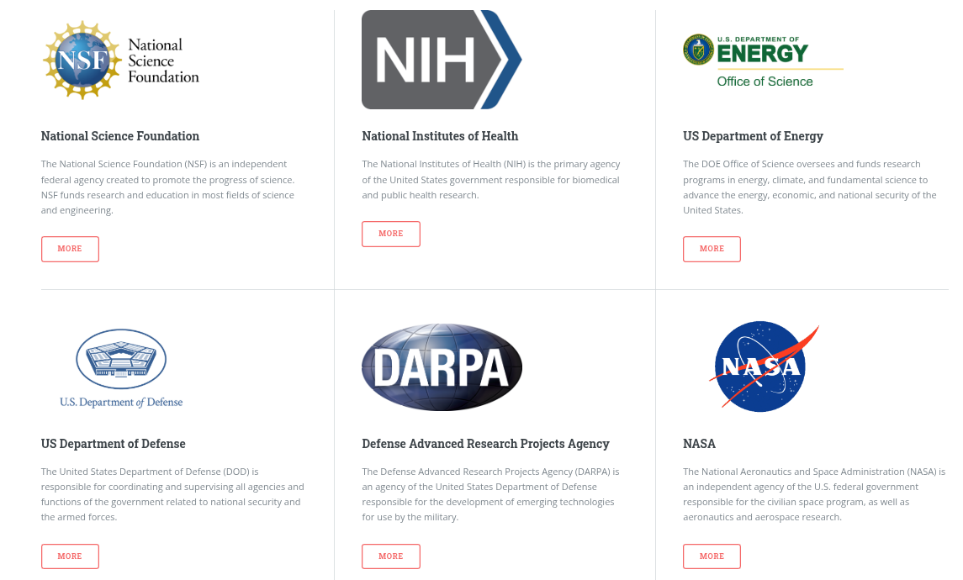
SIUC Research Hub

Slide 21
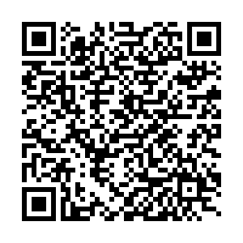
NSF CAREER sample proposals
https://www.dropbox.com/scl/fi/ol2hl5cu3f4l8y6dq7afb/Sample-Proposals.zip?rlkey=m21yhpo98o9dzdho9us90942s&dl=0

Slide 22
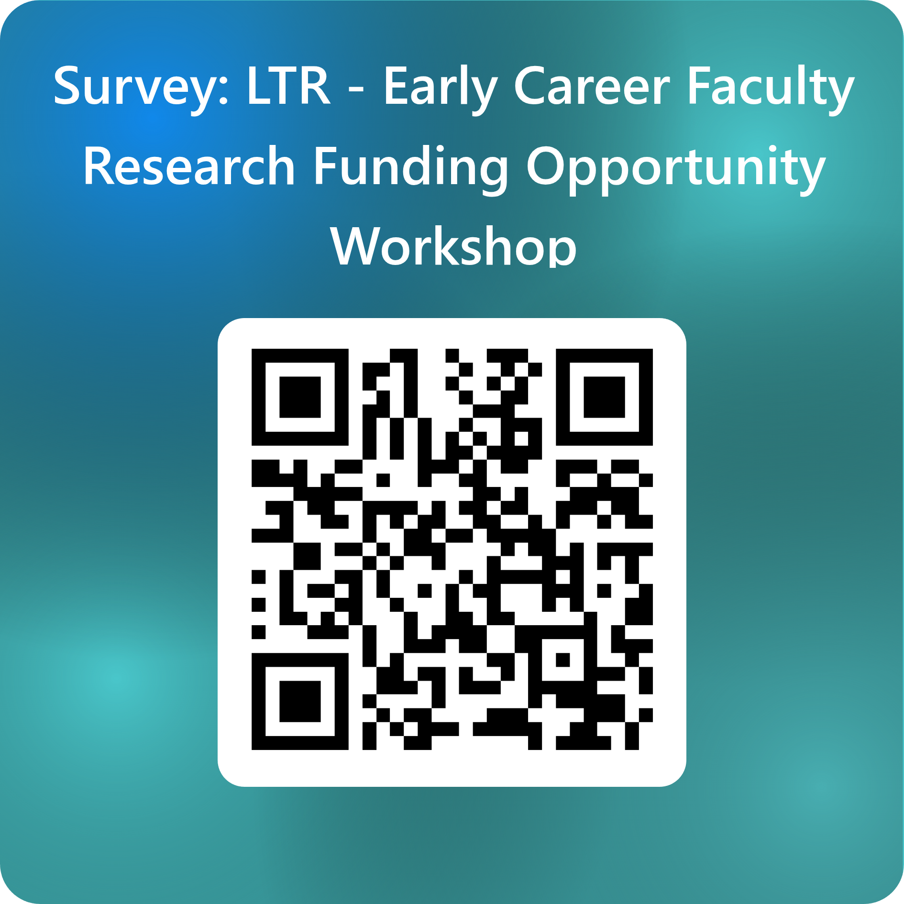
Survey – Please provide feedback
https://forms.office.com/r/kiGhMkEDEA

Slide 23
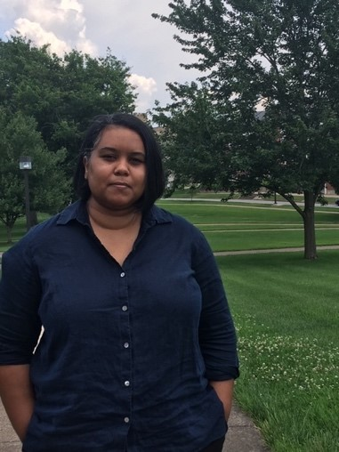
Dr. Senetta Bancroft
Associate Professor, School of Chemical and Biomolecular Sciences and School of Education
Office: 301B Pulliam Hall
Phone: 618-453-4244
E-mail: senetta.bancroft@siu.edu

Slide 24
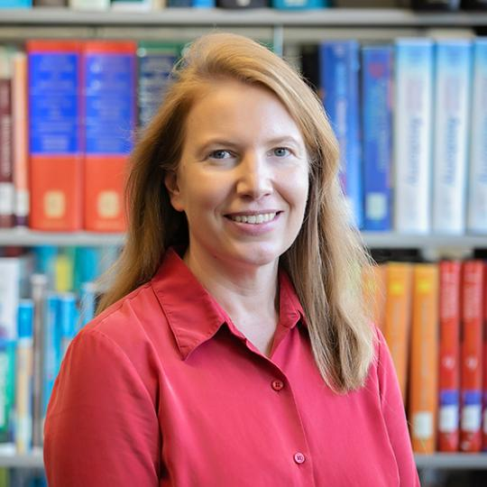
Dr. Judy Davie
Associate Professor and Chair, Department of Biomedical Sciences
Phone: 618-453-5002
E-mail: jdavie@siumed.edu

Slide 25
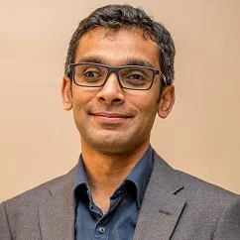
Dr. Lahiru Jayakody
Assistant Professor, Department of Microbiology
Office: Life Science II, 139
Phone: 618-453-2767
E-mail: lahiru.jayakody@siu.edu

Slide 26
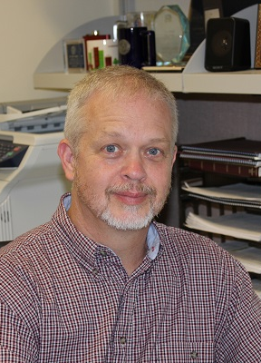
Dr. Gary R. Kinsel
Professor, Research & Innovation Strategist, School of Chemical and Biomolecular Sciences
Phone: 618-453-6482
E-mail: gkinsel@chem.siu.edu

Slide 27
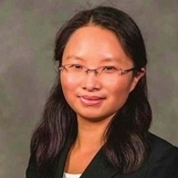
Dr. Jia Liu
Associate Professor, School of Civil, Environmental and Infrastructure Engineering
Office: Engineering B, Room 116
Phone: 618-453-7006
E-mail: jialiu@siu.edu

Slide 28
Thank you
Questions

