Slide 1

Research Compliance
Faculty Research Workshop
September 4, 2024

Slide 2
Agenda
  Staff Introductions
  Supported Areas
  Key Information by Area
  Questions & Comments

Slide 3
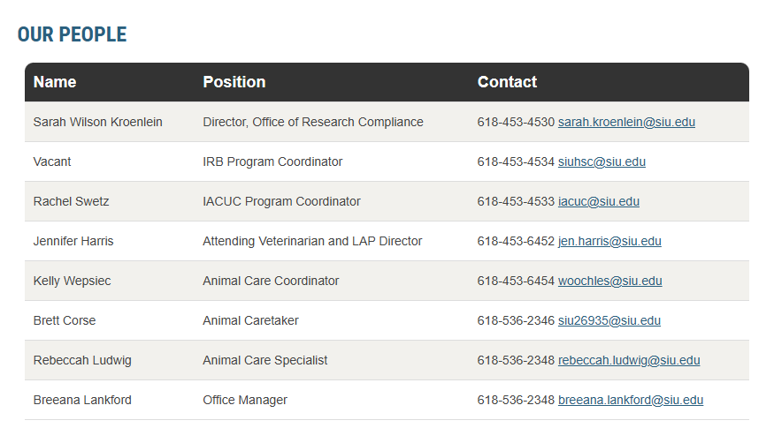
Office of Research Compliance
orc.siu.edu

Slide 4

Office of Research Compliance Mission:
Support and promote ethical research;
Partner with faculty, staff, and students to ensure all research complies with federal regulations, state and local laws, and university policy.

Slide 5

Office of Research Compliance
  Institutional Review Board (IRB)
  Animal Care & Use Committee (IACUC)
  Lab Animal Program (LAP)
  Institutional Biosafety Committee (IBC)
  Financial Conflicts of Interest Committee (FCOI)
  Responsible & Ethical Conduct of Research (RECR)

Slide 6

Institutional Review Board (IRB)
  The SIUC IRB reviews all human subjects research projects conducted by individuals affiliated with SIU before any human subject involvement.
  Research with human subjects cannot begin until an official approval letter is received from the IRB.
  Submit the completed application and all supporting documents to siuhsc@siu.edu.
  Review typically occurs within two to four weeks; complex protocols may require additional processing.
  ***Peak application cycles may impact review time***

Slide 7
IRB Review Levels
Exempt Review | Exempt does not = exempt from review! Minimal risk (no greater than risk ordinarily encountered in daily life) and only includes procedures or types of research listed in one of the HHS exempt categories. Minors cannot serve as participants in certain exempt categories. Cannot include prisoners as research participants.
Expedited Review | No more than minimal risk and only include procedures or types of research listed in one of the HHS expedited categories. Cannot be used for classified research. Cannot include prisoners as research subjects.
Full Board Review | Protocols that do not meet the requirements for exempt or expedited categories. When requesting a waiver of written consent.
Determination Letter (Not Human Subjects Determination) | Data repositories may require a determination letter before accessing sensitive de-identified human subjects data. Journals and granting agencies may require a determination letter. Remember, the IRB cannot provide post hoc review. Determination requests must be submitted before the research begins.

Slide 8

  Sample consent and recruitment forms are available on the SIUC IRB website (orc.siu.edu/human-subjects-research)
  Student PIs must have a faculty co-signer and “cc” this individual when emailing the IRB.
  PIs should consult with procurement and/or OSPA before using grant or state funds to purchase participant incentives.
  Study modification requests should include a memo outlining the request and updated application materials.
  PIs and key personnel must complete CITI training.
  Consult the IRB’s Guidance for Class Projects regarding projects designed solely to provide students with training about and experience with research methods.
Additional
IRB
Information

Slide 9
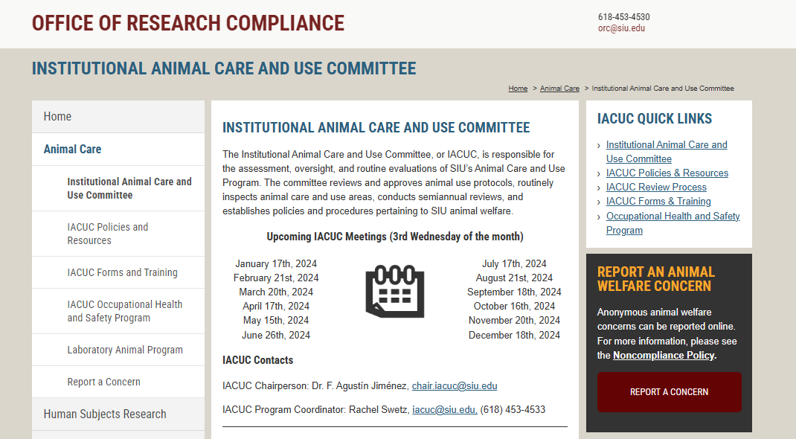
SIUC’ s IACUC is responsible for the oversight and assessment of all vertebrate animals and cephalopods used in research, testing, and teaching on the SIUC campus.
orc.siu.edu/animal-care

Slide 10

IACUC Review Process
Protocol applications and supporting documents are submitted to iacuc@siu.edu.
Submissions undergo a pre-review by the administrative office and are then reviewed by Designated Member Review or Full Committee Review.
Approved protocols are valid for three years.

Slide 11
  Students cannot serve as PIs.
  PIs must have adequate training in the tasks they propose to perform, complete additional CITI training, and enroll in the Occupational Health Program.
  Wildlife observational studies that elicit engagement, include disturbance, and/or visits to breeding areas and nests require IACUC approval.
  The IACUC cannot provide review after the fact. Requests for approval and/or determination letters must be made before the start of any animal activities.
  The LAP provides animal management and veterinary medical care in a limited-access, secure facility.
Additional
IACUC Information

Slide 12

Institutional Biosafety Committee
Reviews, approves, and oversees all projects involving potentially hazardous biological materials or recombinant DNA.
PI submits MUA to BSO and/or IBC chair.
All personnel involved in the experimental work must receive training regarding biological safety practices and procedures.
Approved MUAs are valid for three years.

Slide 13
Financial Conflict of Interest Policy & Committee
The FCOI policy was established to promote objectivity in research by establishing standards that reasonably expect that the design, conduct, and reporting of research funded by federal grants or cooperative agreements will be free from bias resulting from investigator financial conflicts of interest.
FCOI disclosure statement must be completed by all investigators responsible for the design, conduct or reporting of a federally funded research grant or cooperative agreement.
For additional information email rcr@siu.edu.

Slide 14
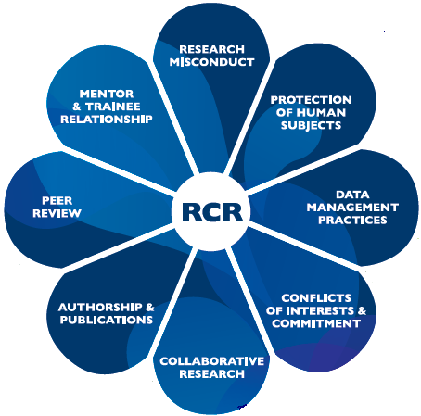
Responsible and Ethical Conduct of Research
  All researchers have the ethical obligation to conduct their university-sanctioned research responsibly and to train their staff and students in the responsible conduct of research
  Certain granting agencies require RCR training.
  The Office of Research Compliance provides training through CITI and hosts a variety of workshops and events throughout the academic year.

Slide 15
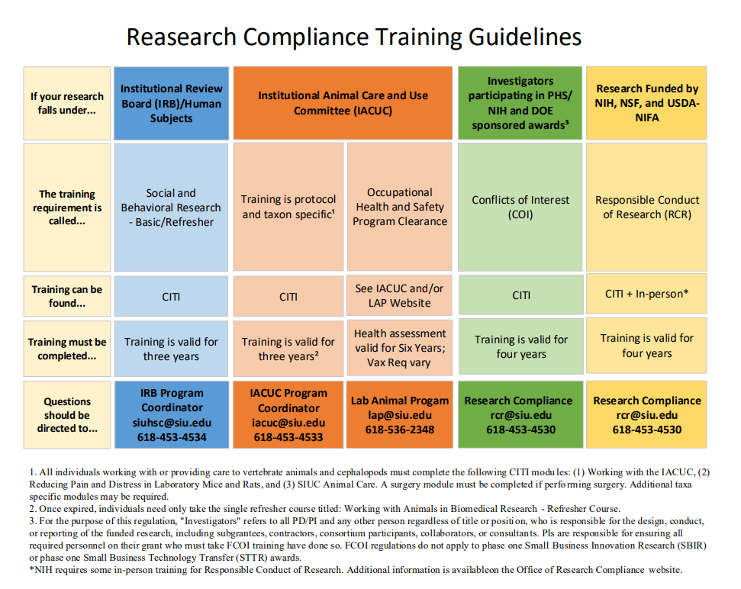

Slide 16


Q&A Session
Thank you for listening!

