Slide 1

Ready, Set, Fund!
OSPA – New Faculty Orientation
Notes:
.

Slide 2
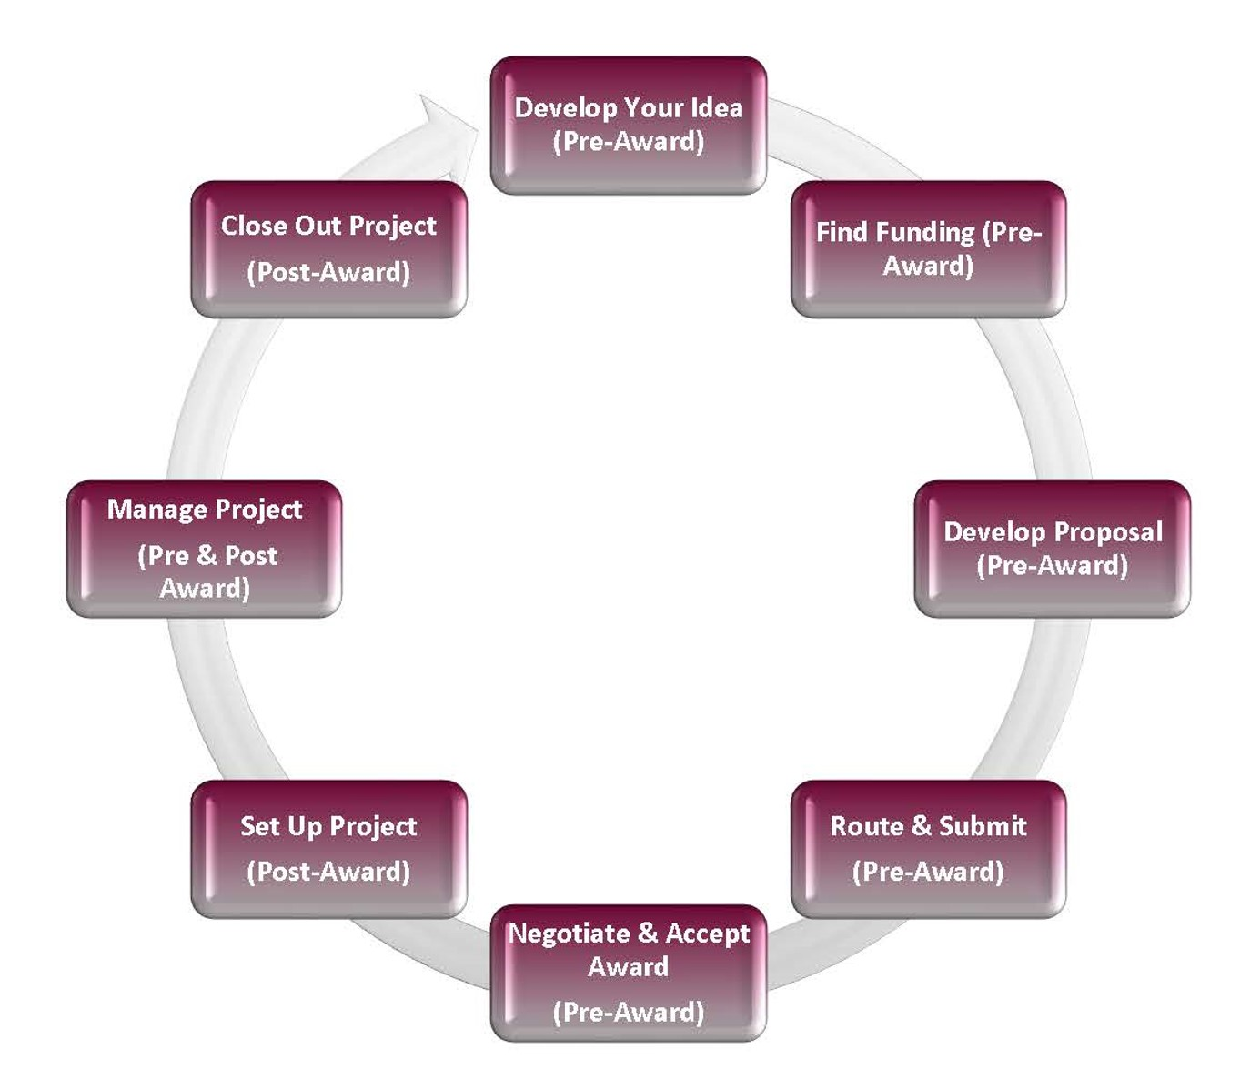
Who We Are
Office of Sponsored Projects Administration (OSPA)
We help faculty navigate externally sponsored projects (e.g. grants and contracts)
Your partners in research success.

Slide 3
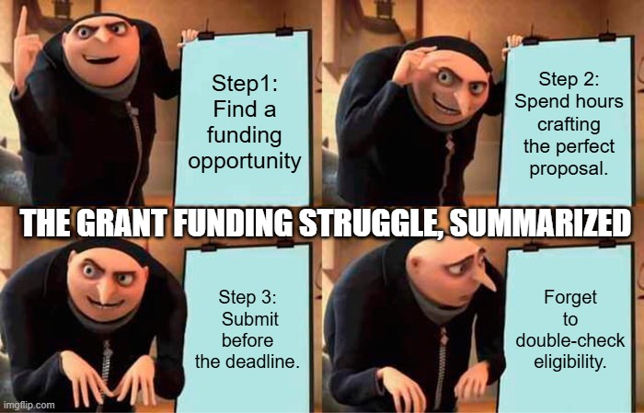
What We Do
Assist in identifying funding opportunities
Assist with proposal development and submission
Negotiate and accept awards
Post-Award Administration
Manage Grant Compliance Requirements
Provide Training and Resources
Manage Audits (internal and external)

Slide 4
Proposal Deadlines & Required Documents
Deadline | Proposal Documents
As soon as possible (at least 3 weeks prior to sponsor deadline) | Submit your proposal notification on the OSPA website
10 Business Days (prior to sponsor deadline) | OSPA Budget, Budget Justification, Brief Description of Work, Subaward Budget, Cost Share Form
5 Business Days (prior to sponsor deadline) | Subaward Package, Senior Personnel Documents, Completed Budget in Sponsor Format/Portal, Approved Cost Share Form
3 Business Days (prior to sponsor deadline) | Proposal Checklist, FCOI for all SIU Personnel, Project Description, Remaining sponsor-required documents
1 Business Day (8 a.m. the day before sponsor deadline) | Finalized full proposal in sponsor-required format/portal
Note: OSPA cannot guarantee submission unless all required documents are received in the office 3 business
days before the submission deadline.

Slide 5
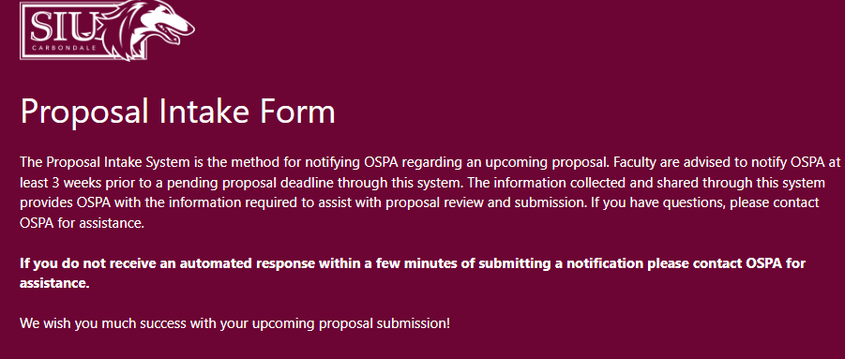
Proposal Intake System

Slide 6

Who Submits?
Long story short…!
Bottom line is all proposals, whether it’s electronic or hard copy, OSPA submission or PI submission, OSPA reviews and “green-lights” all proposals prior to submission.

Slide 7
Congratulations – you’ve just won yourself a brand-new set of responsibilities!

Slide 8
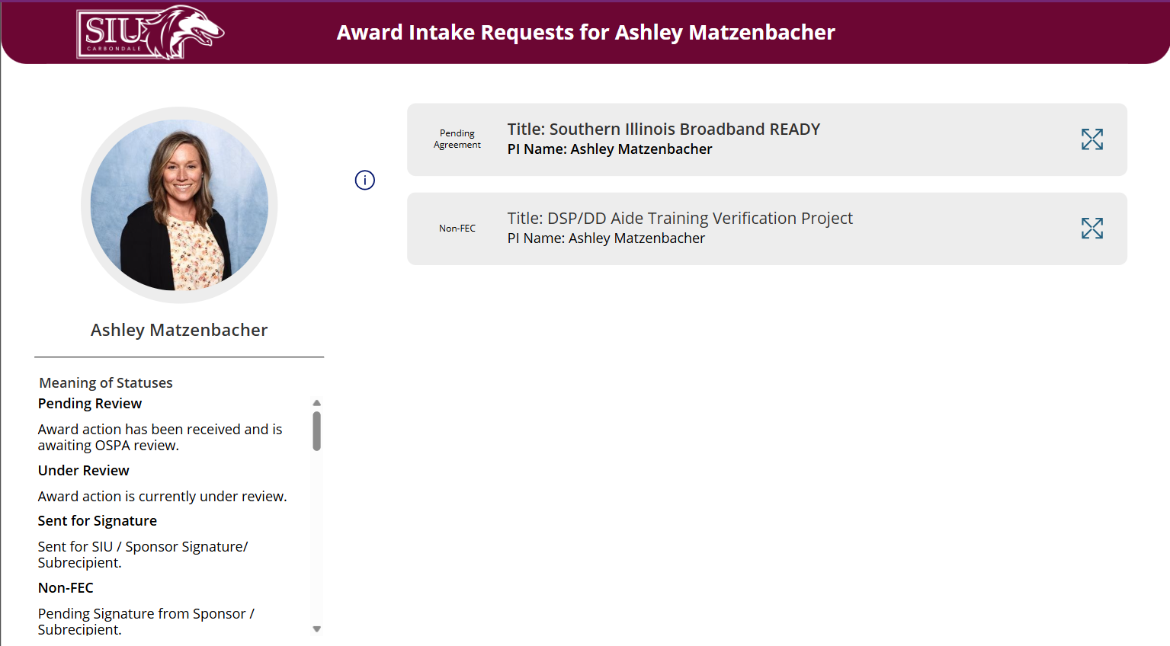
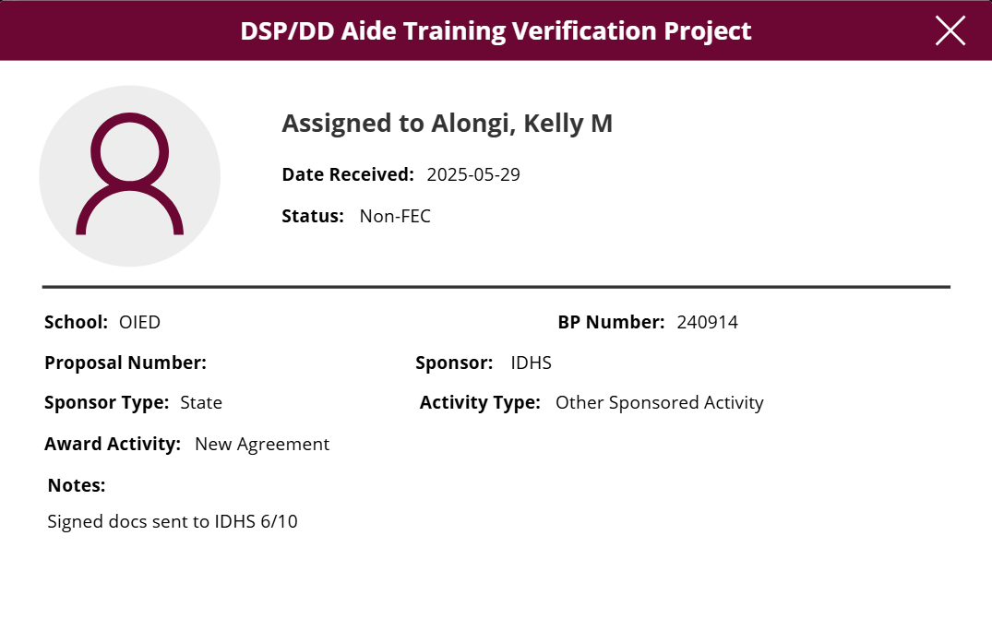
Award Intake System

Slide 9
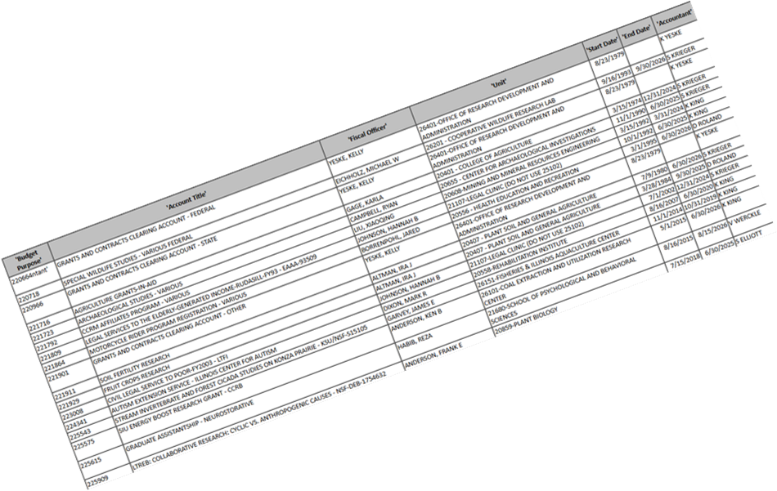
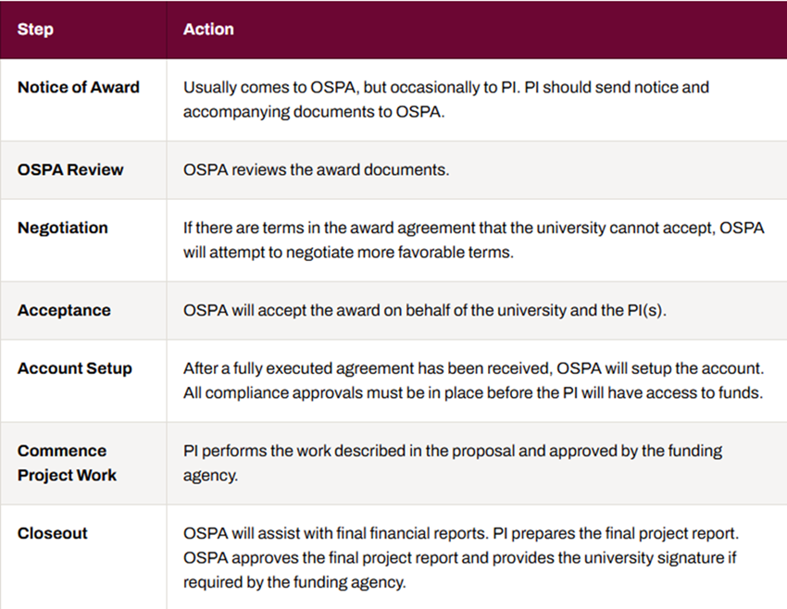
Award Management
Overview
Grant Accountant

Slide 10
Key Resources
OSPA Website - https://ospa.siu.edu/
Institutional Information - https://ospa.siu.edu/apply/institutional-information.php
Required Forms - https://ospa.siu.edu/forms.php
Policies and compliance information
  University Policies Affecting Research - https://ospa.siu.edu/resources/policies.php
  OSPA Guidelines and Procedures- https://ospa.siu.edu/resources/guidelines-procedures.php
Proposal and Award Reports
New Faculty Quick-Start Guide
Contact Directory - https://ospa.siu.edu/about-ospa/our-team.php

Slide 11

Kuali Research – Coming Soon
Cloud-based system for Proposal Preparation and Approvals
Track pending and awarded projects
Current and Pending Support Reports

Slide 12

PIVOT – RP Overview
  What is it?
    Subscription service provided by OVCR to all SIUC faculty, staff, and students
    Database of assistance opportunities and potential collaborators
  Set up your account
  Claim/create your profile
  Tips/tricks

Slide 13
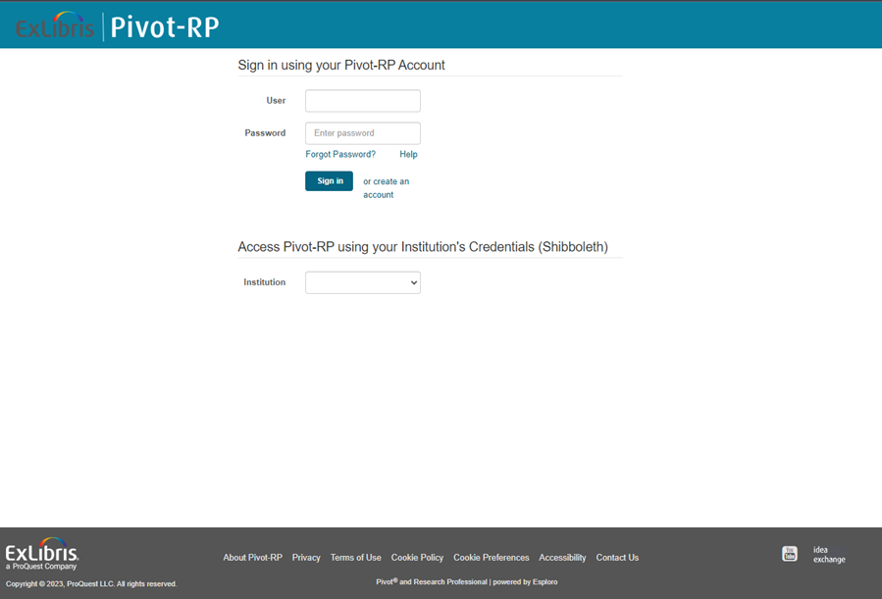
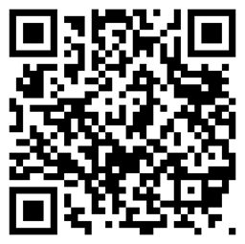
Setting Up Your Account
Logged in on your computer, go to ospa.siu.edu > Click on the PIVOT quicklink on the right > and click on the pivot.proquest.com link.

Slide 14
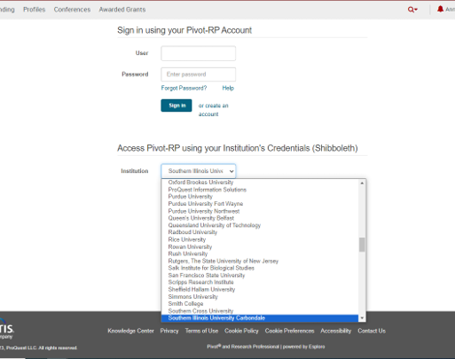
Setting Up Your Account
Select Southern Illinois University Carbondale from the Institution dropdown menu.

Slide 15
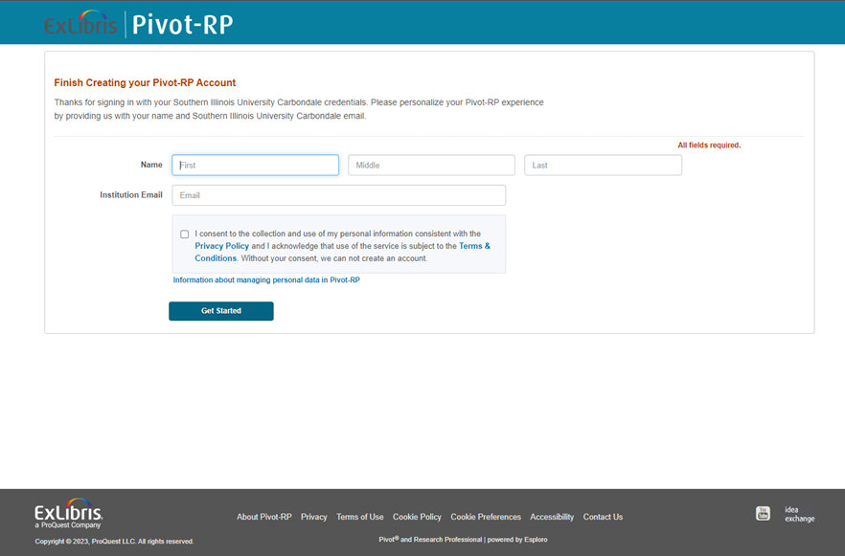

Setting Up Your Account
Finish creating your account: enter your name and institution email, check the box and click Get Started

Slide 16
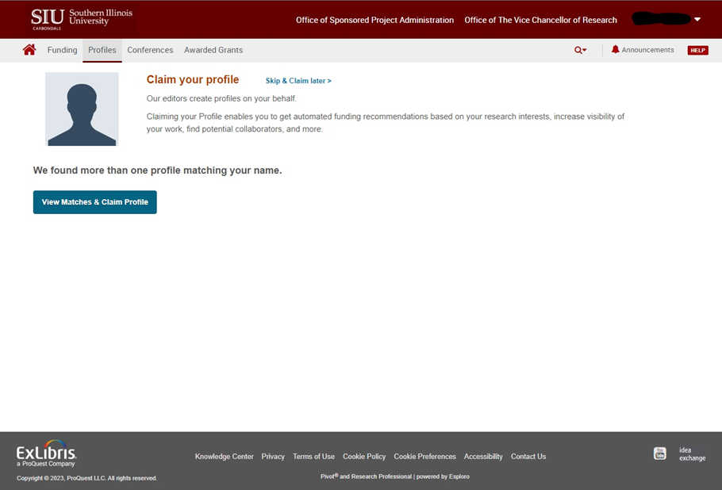
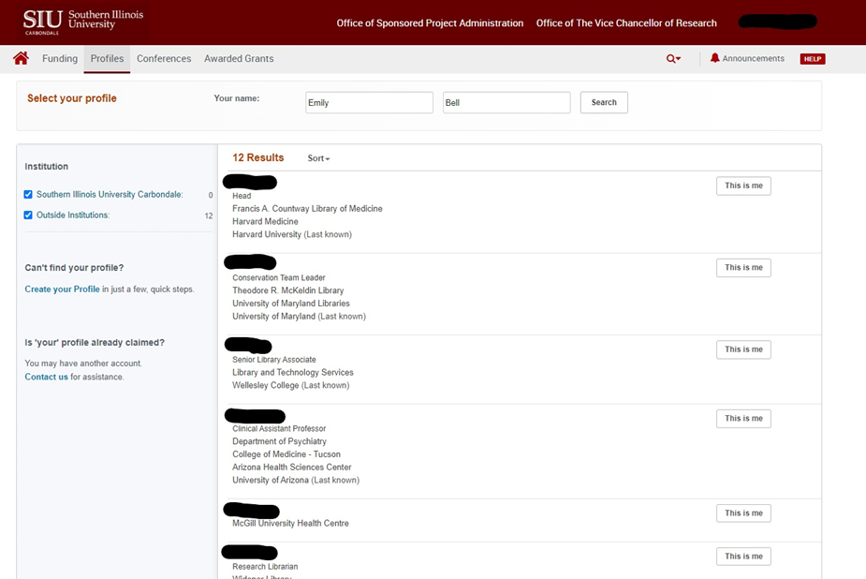


Claiming or Creating Your Profile
There may already be a matching profile – view to claim a profile.
If none of the matches is actually you, click on Create your Profile:

Slide 17
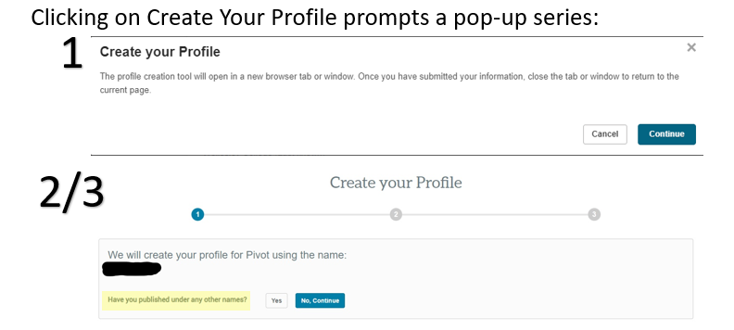
Claiming or Creating Your Profile

Slide 18
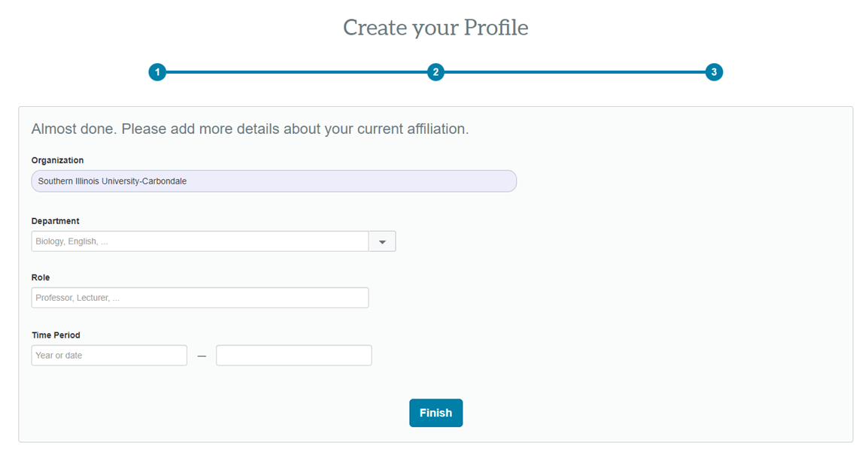

Claiming or Creating Your Profile

Slide 19
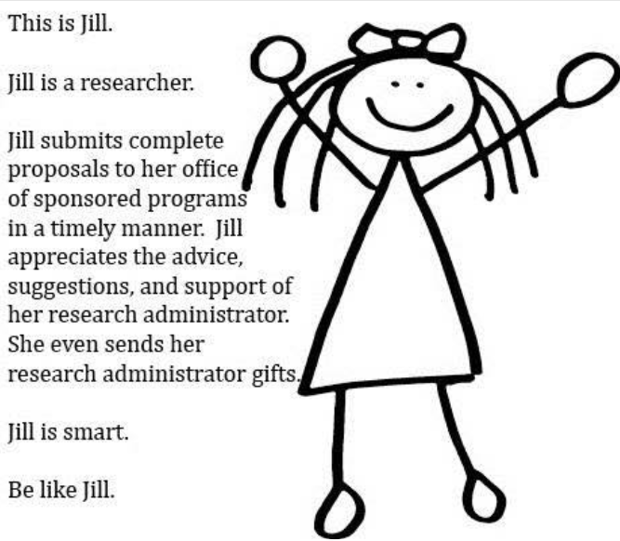
How to Reach Us
Email: ospa@siu.edu
Phone: 618-453-4540
Office: Woody Hall, 3rd Floor
We’re here to help – reach out anytime!

Slide 20

Questions

