Slide 1

Research Compliance
Sarah Kroenlein, PhD
Director, Office of Research Compliance
Southern Illinois University
Woody Hall 376 | 900 South Illinois Ave | MC 4344
Carbondale, IL 62901
sarah.kroenlein@siu.edu
618-453-4530
ORC.SIU.EDU

Slide 2

You don’t often think about your plumbing…until

Slide 3

A blueprint serves as the foundation of a house (much like a research plan).
The best-designed plans include strong:
Safety systems that prevent disaster
Protections for contributors/participants
Transparent financials and ethical practices
Compliance with codes and regulations
That’s where we come in.

Slide 4

What happens when systems are missing?
Project delays from missing approvals
Loss of funding due to noncompliance
Retractions or reputational harm
Risks to participants, animals, or research teams
Audits or investigations
Our job is to help prevent these issues — but it’s also up to you.
Connect with us early. Ask questions. Let us help.

Slide 5
Office of Research Compliance (ORC)
Functional Areas:
  Institutional Review Board (IRB)
  Animal Use & Care Committee (IACUC)
  Lab Animal Program (LAP)
  Institutional Biosafety Committee (IBC)
  Financial Conflicts of Interest (FCOI)
  Responsible & Ethical Conduct of Research (RECR)

Slide 6

Institutional Review Board (IRB)
  The SIUC IRB reviews all human subjects research projects conducted by individuals affiliated with SIU before any human subject involvement.
  Research with human subjects cannot begin until an official approval letter is received from the IRB.
  Submit the completed application and all supporting documents to siuhsc@siu.edu.
  Review typically occurs within two to four weeks; complex protocols may require additional processing.
  ***Peak application cycles may impact review time***

Slide 7
IRB Review Levels
Exempt Review | Exempt does not = exempt from review! Less than minimal risk (ordinarily encountered in daily life) and only includes activities allowable under one of the HHS exempt categories. Minors cannot serve as participants in certain exempt categories. Cannot include prisoners as research participants.
Expedited Review | Not greater than minimal risk and only includes activities allowable under one of the HHS exempt categories. Cannot be used for classified research. Cannot include prisoners as research subjects.
Full Board Review | Protocols that do not meet the requirements for exempt or expedited categories. When requesting a waiver of written consent.
Determination Letter (Not Human Subjects Determination) | Data repositories may require a determination letter before accessing data. Journals and granting agencies may require a determination letter. Remember, the IRB cannot provide post hoc review. Determination requests must be submitted before you begin.

Slide 8
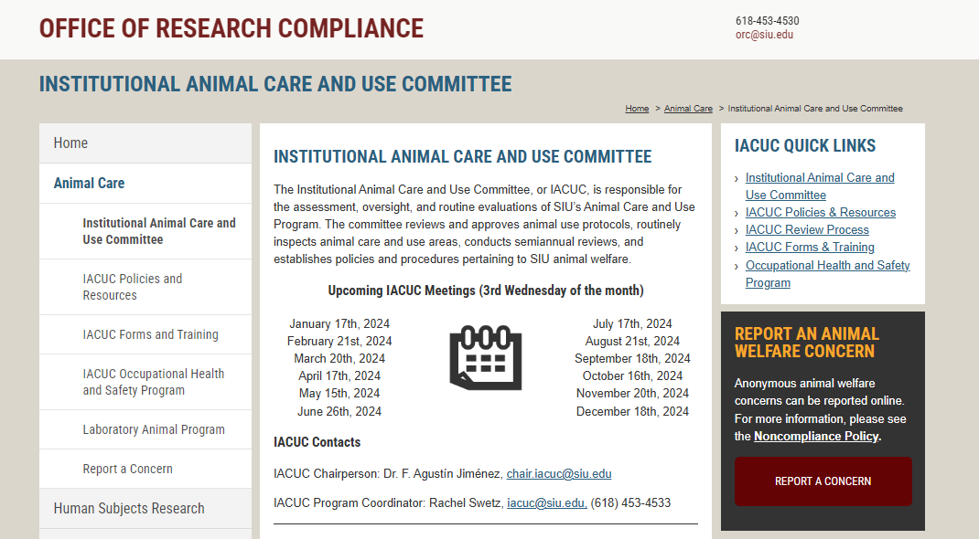
SIUC’ s IACUC is responsible for the oversight and assessment of all vertebrate animals and cephalopods used in research, testing, and teaching on the SIUC campus.
orc.siu.edu/animal-care

Slide 9

IACUC Review Process
Protocol applications and supporting documents are submitted to iacuc@siu.edu.
Submissions undergo a pre-review by the administrative office and are then reviewed by Designated Member Review or Full Committee Review.
Approved protocols are valid for three years.

Slide 10

  The IACUC cannot provide review after the fact. Requests for approval and/or determination letters must be made before the start of any animal activities.
  Students cannot serve as PIs.
  PIs must have adequate training in the tasks they propose to perform, complete additional CITI training, and enroll in the Occupational Health Program.
  Wildlife observational studies that elicit engagement, include disturbance, and/or visits to breeding areas and nests require IACUC approval.
  The LAP provides animal management and veterinary medical care in a limited-access, secure facility.
Additional
IACUC Information

Slide 11

Institutional Biosafety Committee
Reviews, approves, and oversees all projects involving potentially hazardous biological materials or recombinant DNA.
PI submits MUA to BSO and/or IBC chair.
All personnel involved in the project must receive training regarding biological safety practices and procedures.
Approved MUAs are valid for three years.

Slide 12
Financial Conflict of Interest Policy & Committee
The FCOI policy was established to promote objectivity in research by establishing standards that reasonably expect that the design, conduct, and reporting of research funded by federal grants or cooperative agreements will be free from bias resulting from investigator financial conflicts of interest.
FCOI disclosure statement must be completed by all investigators responsible for the design, conduct or reporting of a federally funded research grant or cooperative agreement.
For additional information email rcr@siu.edu.

Slide 13
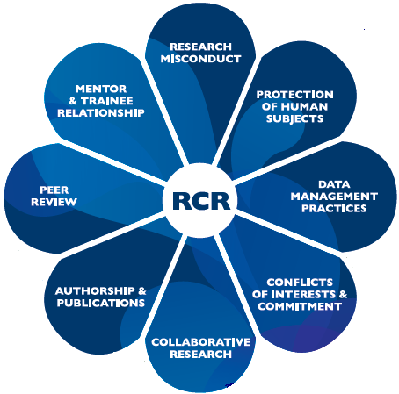
Responsible and Ethical Conduct of Research
  All researchers have the ethical obligation to conduct their university-sanctioned research responsibly and to train their staff and students in the responsible conduct of research.
  The Office of Research Compliance provides training through CITI and hosts a variety of workshops and events throughout the academic year.
  RCR, RST, and COI training is required before submitting federal grant applications.

Slide 14
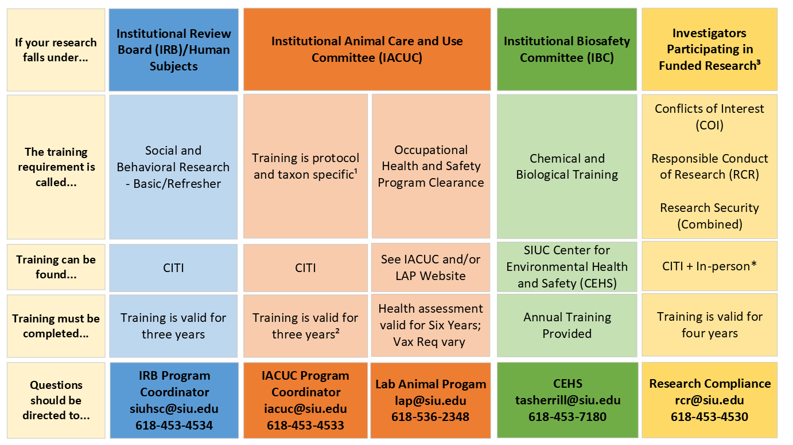

Slide 15


Office of Research Compliance
Woody Hall 376
618-453-4530
orc.siu.edu

